Slide 1
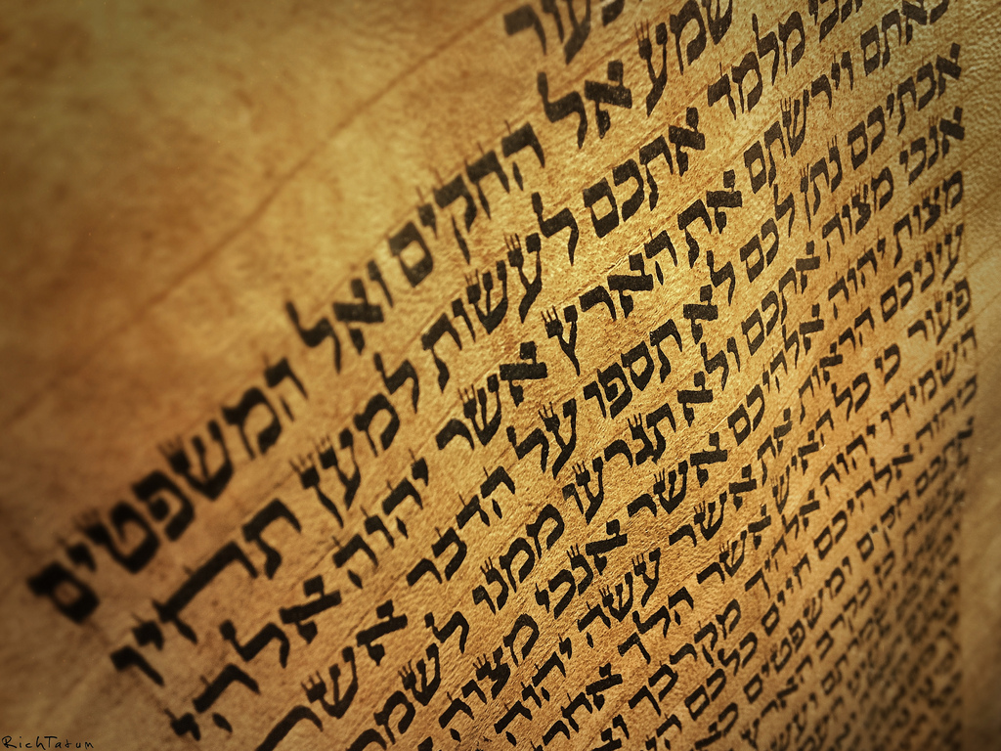
The “Book” of Jeremiah
Jeremiah 36

Slide 2
The Setting
640 BC — Josiah becomes King
627 BC — Jeremiah called
622 BC — Temple scrolls found
614 BC — Fall of Ashur
612 BC — Fall of Nineveh
609 BC — Fall of Haran
605 BC — Babylon defeats Egypt at Carchemish

Slide 3
The Story of The Book
Jeremiah 36
The Book is born (v 1-8)
The Book is read (v 9-19)
The Book is destroyed (v 20-26)
Pages 6-7

Slide 4
Sad Irony
622 BC – Shaphan the scribe gave God’s book to King Josiah, who read it, tore his clothes, led the nation to repentance
604 BC – son of Shapan the scribe gave God’s book to the son of Josiah, who read it, tore the book, led the nation into apostasy
See 2 Kings 22.8-11

Slide 5
The Story of The Book
Jeremiah 36
The Book is born (v 1-8)
The Book is read (v 9-19)
The Book is destroyed (v 20-26)
The Book is vindicated (v 27-31)
The Book is continued (v 32)
Pages 6-7

Slide 6
Time Lapse Prophecy
Jeremiah’s calling – 627 BC
Jeremiah’s 1st scroll – 605 BC
Jeremiah’s last prophecy – 584 BC?
43 years of preaching
21 years to compile the book
Pages 6-7

Slide 7
Baruch’s Role & Influence
Scribe
Access to temple
Familiarity with temple officials
Protected by high-ranking officials
Encouraged by God
Known by commoners
Pages 7-8

Slide 8
Jeremiah as a Prophet
Israelite prophecy – Dt 18.9-14
Testing their words – Dt 18.20ff; 13.1ff
Within 150 years of end of OT
Called & equipped by God – Jer 1.1ff
Protected by God – Jer 1.17ff
Pages 1-3

Slide 9
Jeremiah’s Audience
Temple worshippers – Jer 7
Judah’s kings – Jer 22; 36
Foreign kings – Jer 27.1ff; 46-51
False prophets & priests – Jer 21ff; 27ff
Exiles – Jer 29
Remnant in the land – Jer 42-43
Pages 1-3

Slide 10
Jeremiah’s “Sermon Illustrations”
Shunned social norms – Jer 16
Ruined waistband – Jer 13.1-11
Clay pots – Jer 18-19
Ox yoke – Jer 27-28
Letters – Jer 29
Real estate purchase – Jer 32
Wine banquet – Jer 35
Scrolls – Jer 36; 51
Stones – Jer 43
Pages 3-4

Slide 11
Jeremiah’s Enemies
Hometown & family – Jer 11-12
False prophets – Jer 20
Angry worshippers – Jer 26
Kings – Jer 36, 38
Various officials – Jer 37
Refugees – Jer 43
Page 4

Slide 12
Skeptics & Inspiration
“They [fundamentalists] attach this view to the belief that the Bible is inspired by God, a belief which they also base on a few texts within it. They cite particular verses about ‘inspired scripture’ which they interpret to suit their own views and extend them as a description of the entire Bible, as if the Bible is proven to be inspired because one bit of it (arguably) says so.” (Robin Lane Fox)
Page 5

Slide 13
Jeremiah’s Skeptics
Destroy the message – Jer 36
Destroy the messenger – Jer 20; 37-38
Decide before hearing – Jer 42-43
Disagree after hearing – Jer 27-28
Seek God’s blessings without obedience – Jer 21
Pages 5-6

Slide 14
Jeremiah’s Legacy & Influence
Nebuchadnezzar’s protection of Jeremiah (Jer 40.1-6)
People identified Jeremiah with Jesus (Mt 16.13f)
Paul identified himself with Jeremiah (2 Co 10.8; 13.10)
Pages 9-10

Slide 15
Political Setting of Jeremiah
Fall of Assyria
Rise of Babylon
Decline of Egypt
Pages 10-11

Slide 16
Spiritual Setting of Jeremiah
Corrupt citizens
Corrupt priests & prophets
Corrupt political leaders
Pages 11-12

Slide 17
Chronology of Jeremiah
Key Dates (p. 12f)
Synchronisms (p. 13)
Chronology & text (Appendix 1, pp. 33-34)

Slide 18
Chronology & Structure
Several chronological schemes:
David Dorsey (p. 13)
Edward J. Young (p. 13ff)
R. K. Harrison (p. 15)
William Holladay (p. 15f)

Slide 19
Jeremiah & Archaeology
Lachish Ostraca
Clay Seals
Babylonian Chronicles
Pages 16-21

Slide 20
Lachish Ostraca
Pages 17-18

Slide 21
Clay Seals
Pages 18-20

Slide 22
Seal of Baruch – Fake!
See – BASOR (Bulletin of the American Schools for Oriental Research) #372 (Nov 2014), 147-158. “The Authenticity of the Bullae of Berekhyahu Son of Neriyahu the Scribe.” Authors: Yuval Goren & Eran Arie
Pages 18-20

Slide 23
Babylonian Chronicles
Page 20

Slide 24
People in Jeremiah
Over 80 personal names
Over 60 people in the story
Includes:
Israelite Rulers
Foreign Rulers & Military Figures
Religious & Political Figures
Others
Pages 21-24

Slide 25
Hebrew & Greek Texts
Different order (major & minor sections)
LXX is 1/8 shorter than MT (2700 words)
Both editions supported by DSS
Did Jeremiah or Baruch release an early edition?
Pages 24-25

Slide 26
Themes
“Persistence”
“Egypt”
“Covenant”
“False worship & false righteousness”
“Turn & return”
“Plant/uproot” & “build/tear down”
Sickness & healing
“70” years
Pages 25-29

Slide 27
Structure – Large Scale
Chp 1-25 – Judgment of Judah & Jerusalem
Chp 26-29 – prose episodes from Jeremiah’s life
Chp 30-33 – “book of consolation”
Chp 34-45 – prose episodes from Jeremiah’s life
Chp 46-51 – oracles against the nations
Pages 29-30

Slide 28
David Dorsey’s Outline
A: Against Judah: Invasion & disaster from north (1:1 – 12:17)
B: Judah’s coming exile & suffering (13:1 – 20:18)
C: Dated messages of judgment (21:1 – 29:32)
D (Center): Messages of future hope (30.1 – 33.26)
C’: Dated messages of Judgment (34:1 – 35:19)
B’: Judah’s fall & exile (36.1 – 45.5)
A’: Against the nations: Invasions & disasters from north (46:1 – 51:64)
Appendix: Fall of Jerusalem (52:1-34)
Pages 30-32

Slide 29
Things I Need to Learn
Danger of tradition in instruction
Jeremiah’s passion for the word
Hope in God’s word

