Slide 1
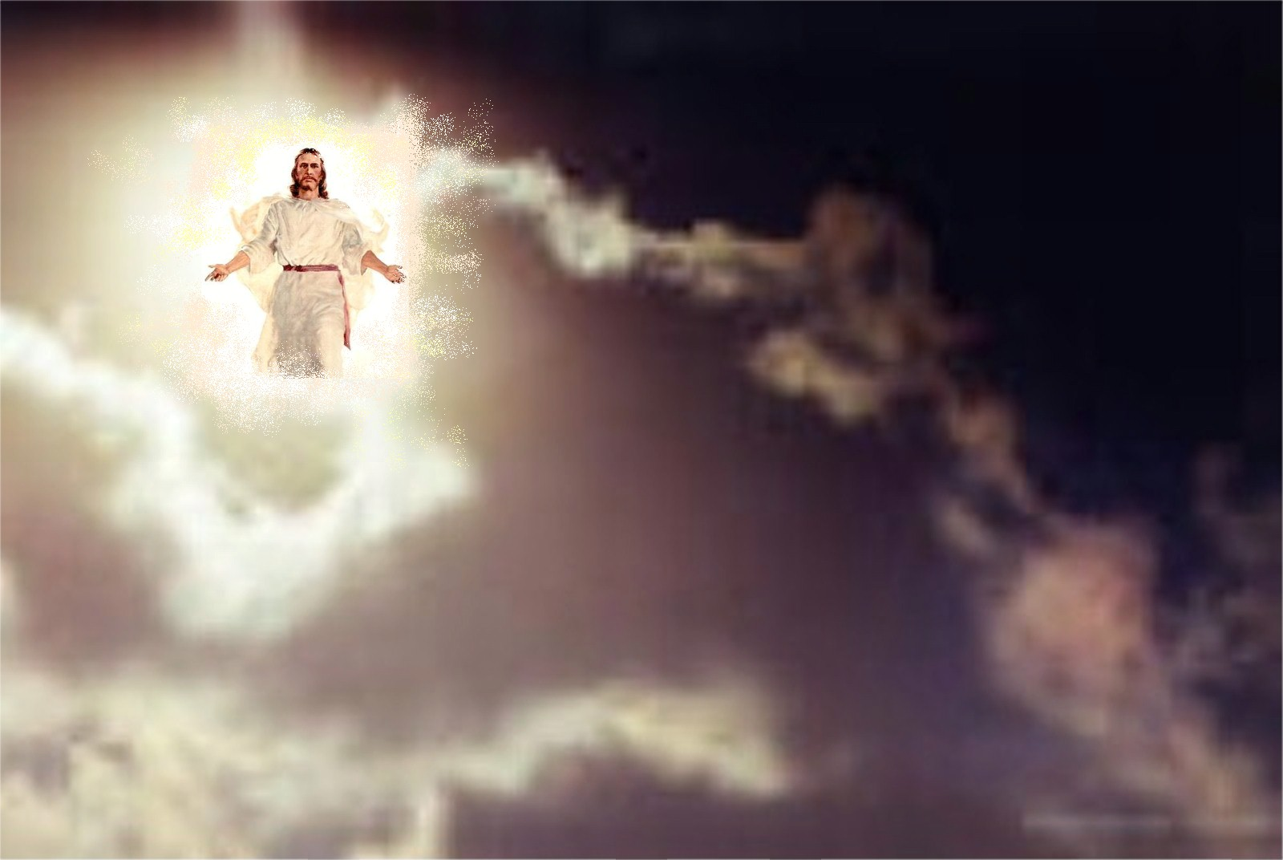
The Coming Of
The Lord
2012 SITS Conference
Kevin Kay

Slide 2
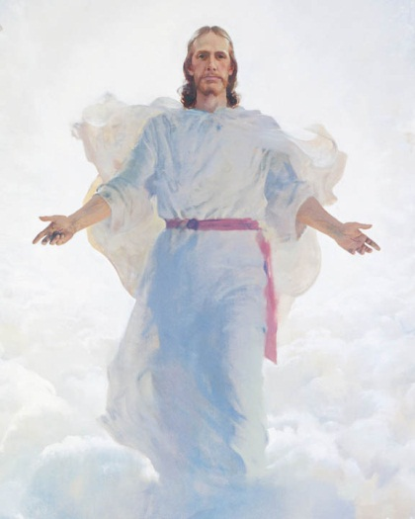
The Second Coming
Heb. 9:26-28: ²⁶ He then would have
had to suffer often since the foundation of
the world; but now, once at the end of the ages, He has appeared to put away sin by the sacrifice of Himself. ²⁷ And as it is appointed for men to die once, but after this the judgment, ²⁸ so Christ was offered once to bear the sins of many. To those who eagerly wait for Him He will appear a second time, apart from sin, for salvation.)

Slide 3
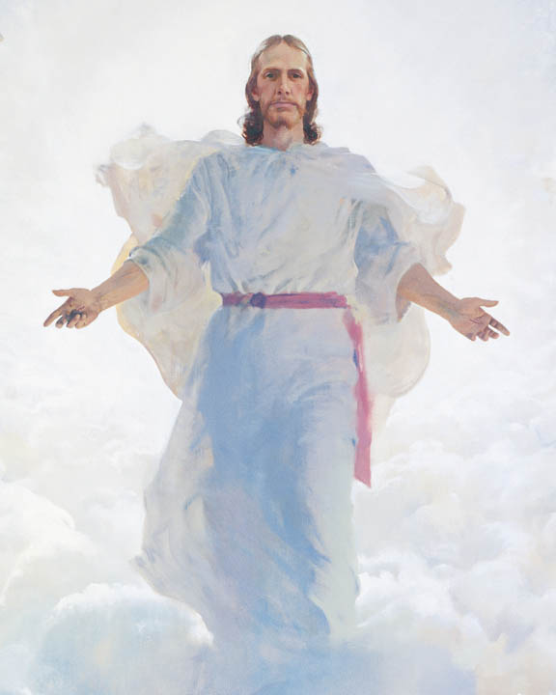
Christ Is Coming Again
Jesus (Mt. 16:27 [?]; Jn. 14:1-4)
Angels (Acts 1:9-11)
Peter (1 Pet. 5:4)
John (1 Jn. 2:28; 3:2)
Hebrews Writer (Heb. 9:28)
Jude (Jude 14)
Paul (1 Cor. 11:26)

Slide 4
The Coming Of The Lord
1 Thessalonians
2 Thessalonians
1:9-10
2:19-20
3:11-13
4:13-18
5:1-11
5:23-24
1:6-10
2:1-12
Over ¼ of 1 Thessalonians
Nearly ½ of 2 Thessalonians
(Wanamaker, NIGTC, 10)

Slide 5
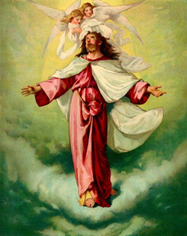
Key Terms For The
Second Coming
“Coming” or “Presence”
(parousia)
“Revelation”
(apokalupsis)
“Appearing” or “Brightness”
(epiphaneia)
“Appearance”
(phaneroo)

Slide 6
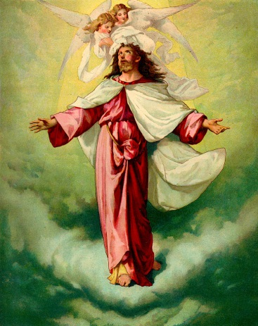
Coming or Presence
(parousia)
Physical coming of men (1 Cor. 16:17;
2 Cor. 7:6-7; Phil. 1:26)
Physical presence (2 Cor. 10:10; Phil. 2:12)
Incarnation (2 Pet. 1:16)
Coming of Christ in AD 70 (Mt. 24:3, 27)
  Second Coming (Mt. 24:37, 39; 1 Cor. 15:23; 1 Th. 2:19; 3:13; 4:15; 5:23; 2 Th. 2:1, 8; Jas. 5:7-8; 2 Pet. 3:4, 12; 1 Jn. 2:28)
Coming of lawless one (2 Th. 2:9)

Slide 7
Revelation
(apokalupsis)
Revelation of God’s word (Lk. 2:32;
Rom. 16:25; 1 Cor. 14:6, 26; Gal. 1:12; 2:2; Eph. 3:3; Rev. 1:1)
Paul’s vision (2 Cor. 12:1, 7)
Second Coming (Rom. 2:5; 8:19; 1 Cor. 1:7; 2 Th. 1:7; 1 Pet. 1:7, 13; 4:13)

Slide 8

Appearing or Brightness
(epiphaneia)
Incarnation (2 Tim. 1:10)
Second Coming (2 Th. 2:8; 1 Tim. 6:14; 2 Tim. 4:1, 8; Tit. 2:13)

Slide 9
Appearance
(phaneroo)
Incarnation (1 Tim. 3:16; 2 Tim. 1:9-10;
Heb. 9:26; 1 Pet. 1:20; 1 Jn. 1:2; 3:5, 8)
Jesus’ revelation to Israel (Jn. 1:31)
Post-resurrection appearance (Mk. 16:12, 14; Jn. 21:1, 14)
Second Coming (1 Cor. 4:5; Col. 3:4; 1 Pet. 5:4; 1 Jn. 2:28; 3:2)

Slide 10

1 Thess. 1:9-10
⁹ For they themselves declare
concerning us what manner of entry
we had to you, and how you turned to God from idols to serve the living and true God, ¹⁰ and to wait for His Son from heaven, whom He raised from the dead, even Jesus who delivers us from the wrath to come.

Slide 11

Second Coming
Salvation (1:10)

Slide 12
1 Thess. 2:19-20
¹⁹ For what is our hope, or joy,
or crown of rejoicing? Is it not even
you in the presence of our Lord Jesus Christ at His coming? ²⁰ For you are our glory and joy.

Slide 13
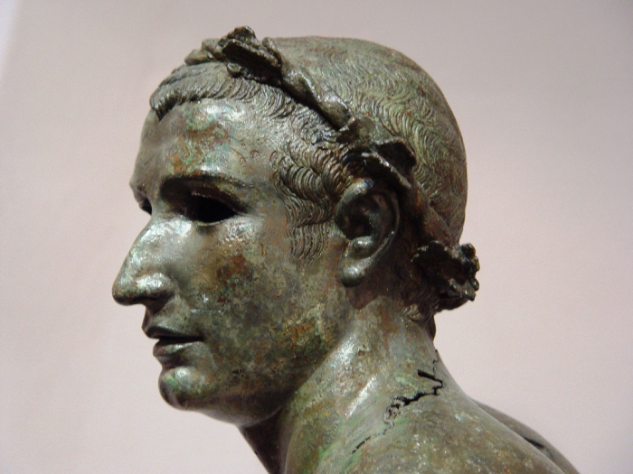
Hope, Joy, Crown
(1 Th. 2:19-20)
What is our hope?
What is our joy?
What is our crown of rejoicing?
Do We Have Paul’s Passion
For Our Converts?

Slide 14
Second Coming
Salvation (1:10)
Celebration (2:19-20)

Slide 15
1 Thess. 3:11-13
¹¹ Now may our God and Father
Himself, and our Lord Jesus Christ,
direct our way to you. ¹² And may the
Lord make you increase and abound in love to one another and to all, just as we do to you, ¹³ so that He may establish your hearts blameless in holiness before our God and Father at the coming of our Lord Jesus Christ with all His saints.

Slide 16
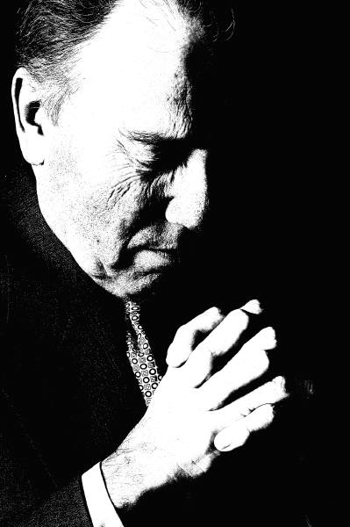
Prayer To Jesus
Jn. 14:12-14
Acts 1:23-26
Acts 7:54-60
Acts 22:17-21
2 Cor. 12:7-10
1 Th. 3:11-13
2 Th. 2:16-17
2 Th. 3:5, 16
1 Tim. 1:12
1 Jn. 5:13-15
Rev. 22:20

Slide 17
John 14:13-14
NKJV: ¹³And whatever you ask in My name, that I will do, that the Father may be glorified in the Son. ¹⁴If you ask anything in My name, I will do it. (ASV; KJV; RSV; YLT)
NASB: ¹³“Whatever you ask in My name, that will I do, so that the Father may be glorified in the Son. ¹⁴“If you ask Me anything in My name, I will do it. (ESV; HCSB; ISV; LEB; NET; NAB; NCV; NIV; NRSV)

Slide 18
Prayer To The Father
Instructions (Mt. 6:6, 9, Lk. 11:2; Acts 8:22; Eph. 5:18-20; Col. 3:16-17)
Examples:
  Pharisee (Lk. 18:11)
  Jesus (Mt. 26:39, 42, 53; Lk. 6:12; Jn. 14:16)
  Cornelius (Acts 10:2)
  Paul & Silas (Acts 16:25; Rom. 1:8; 7:25)
  Women (1 Cor. 11:3)
  Paul (2 Cor. 13:7; Col. 1:3; 2 Th. 1:11)

Slide 19
“Exclude” & “Include”
Exclude: “1. To prevent or keep from entering a place, group, or the like; to bar; reject. 2. To omit noticing or considering; leave out; disregard. 3. To put out (someone or something); expel.” (The American Heritage Dictionary)
Include: “1. To have as a part or member; be made up of, at least in part; contain. 2. To contain as a minor or secondary element; imply. 3. To cause to be a part of something; consider with or put into a group, class, or total.” (The American Heritage Dictionary)

Slide 20
Does This Exclude This?
Faith (Jn. 8:24) | E X C L U D E | Repentance (Acts 17:30)
Repentance (Acts 17:30) |  | Confession (Rom. 10:9-10
Confession (Rom. 10:9-10) |  | Baptism (1 Pet. 3:21)
Prayer to the Father (Mt. 6:9) |  | Prayer to the Son (Jn. 14:13-14)

Slide 21
Paul’s Prayer
(1 Th. 3:11-13)
Paul returned to Macedonia ca. 5 years later (Acts 19:21-22; 20:1-6)
Direct our way to you (11)
  Paul had wanted to see them again (2:17)
  Satan had hindered him (2:18)
  Paul believed in God’s providence (cf. 1 Pet. 5:8-10)
  Paul believed God could expedite his return (Rom. 1:10)
Remember God’s will in our prayers (1 Jn. 5:14-15)
Remember God’s will in our planning (Jas. 4:13-17)

Slide 22
Paul’s Prayer
(1 Th. 3:11-13)
Make you increase and abound (12a)
  Spiritual growth involves the working of God (Phil. 1:6)
  Spiritual growth involves our own efforts (Phil. 2:12-13)
  Paul wants the branches that bear fruit to bear more fruit (Jn. 15:2, 5, 8)

Slide 23
Paul’s Prayer
(1 Th. 3:11-13)
In love to one another and to all (12b)
  Love existed already (1:3; 3:6; 4:9-10)
  Still room for growth (3:12; Phil. 1:9; 3:13-17)
    God answered this prayer (2 Th. 1:3)
  Fellow Christians & outsiders (5:15; Gal. 6:10)
    Their persecutors (Lk. 6:32-35)

Slide 24
Paul’s Prayer
(1 Th. 3:11-13)
Establish your hearts (13)
  Heart = inner man
Blameless in holiness
  Why Jesus gave Himself (Eph. 5:25-27)
  We must cooperate (2 Cor. 7:1)

Slide 25
Sanctification Is A Process
Begins at conversion (1 Cor. 6:11; Eph. 5:26)
Continues throughout our Christian life (Heb. 2:11; 10:14)
Completed at the coming of Christ (1 Th. 5:23)

Slide 26
Paul’s Prayer
(1 Th. 3:11-13)
Before our God and Father
At the coming of our Lord Jesus Christ
With all His saints (“holy ones”)
  Angels
  Christians
  Both

Slide 27
“His Saints” = Angels
(Affirmative Arguments)
Zech. 14:5: You will flee by the valley of My mountains, for the valley of the mountains will reach to Azel; yes, you will flee just as you fled before the earthquake in the days of Uzziah king of Judah. Then the LORD, my God, will come, and all the holy ones with Him! (NASB; cf. ASV; ESV; HCSB; LEB; NET; NAB; NIV; NRSV; RSV; YLT)
  Angels will accompany Jesus at the Second Coming (Mt. 13:41; 25:31; Mk. 8:38; Lk. 9:26; 2 Th. 1:7; Jude 14-15; cf. 1 Enoch 1:9)
  Angels are called “holy ones” in the OT (Dt. 33:2-3; Job 5:1; 15:15; Psa. 89:5, 7; Dan. 4:13; 8:13)
  Paul alludes to Zech. 14:5, and it probably refers to angels

Slide 28
“His Saints” = Angels
(Objections)
  Nowhere else does Paul refer to angels as “saints” or “holy ones”
  NT does not refer to angels as “holy ones” or “saints”
“Angels” do not fit the overall context of the epistle
“Saints” fit the overall context of the epistle (1 Th. 4:13-18)

Slide 29
“His Saints” = Christians
(Affirmative Arguments)
  Paul commonly refers to Christians as “saints” (Rom. 1:7; 8:27; 12:13; 15:25; 1 Cor. 1:2; 6:1-2; 14:33; 2 Cor. 1:1; Eph. 1:1; 2:19; 3:8; Phil. 1:1; 4:21-22; Col. 1:4, 26; 1 Tim. 5:10)
  Christ will be glorified in His saints at His coming (2 Th. 1:10)
  “Holy ones” (1 Th. 3:13) anticipates 1 Th. 4:3-8
  “All” (1 Th. 3:13) anticipates 1 Th. 4:13-18

Slide 30
“His Saints” = Christians
(Objections)
Since the living and resurrected saints will ascend to meet Jesus when He descends (1 Th. 4:15-17), it is unlikely that the “holy ones” (1 Th. 3:13) are dead saints
  Response: Since at death the soul leaves the body (Jas. 2:26) and returns to God (Eccl. 12:7), the disembodied souls of the saints could return with Christ to be reunited with their resurrected & glorified bodies

Slide 31
“His Saints” = Both
(Affirmative Arguments)
          The affirmative arguments for “angels” and “saints” could mean that Paul refers to both angels and saints here

Slide 32
Second Coming
Salvation (1:10)
Celebration (2:19-20)
Sanctification (3:13)

Slide 33
1 Th. 4:13-18
¹³ But I do not want you to be
ignorant, brethren, concerning those
who have fallen asleep, lest you sorrow
as others who have no hope. ¹⁴ For if we believe that Jesus died and rose again, even so God will bring with Him those who sleep in Jesus. ¹⁵ For this we say to you by the word of the Lord, that we who are alive and remain until the coming of the Lord will by no means precede those who are asleep. ¹⁶ For the Lord Himself will descend from

Slide 34
1 Th. 4:13-18
heaven with a shout, with the voice of
an archangel, and with the trumpet
of God. And the dead in Christ will rise
first. ¹⁷ Then we who are alive and remain shall be caught up together with them in the clouds to meet the Lord in the air. And thus we shall always be with the Lord. ¹⁸ Therefore comfort one another with these words.

Slide 35
Why Were The Thessalonians Distressed?
Ignorance
False Teaching
Loss of Hope
Incorrect Inferences
Assumption of the Dead
Lack of Application
Misunderstanding

Slide 36

Death Is Sleep
Men lie down and will not be roused from their sleep (Job 14:12)
Sleep the sleep of death (Psa. 13:3)
Babylon would sleep a perpetual sleep (Jer. 51:39, 56-57)
Those who sleep in the dust will awake (Dan. 12:2)

Slide 37
Death Is Sleep
The bodies of the saints who had fallen asleep (Mt. 27:52-53)
“Our friend Lazarus sleeps” (Jn. 11:11-14)
When Stephen died, he fell asleep (Acts 7:60)
David fell asleep and saw corruption (Acts 13:36)

Slide 38
Death Is Sleep
Dead Christians have fallen asleep (1 Cor. 15:6, 13)
Brethren who die have fallen asleep (1 Th. 4:13-15)
Whether we wake or sleep, we should live with Christ (1 Th. 5:9-11)

Slide 39
The Dead Sleep
It is the body that sleeps, not the soul (Mt. 27:52; Gen. 2:7; 3:19; Eccl. 12:7)
Sleep implies:
  Rest (Rev. 14:13)
  Nonparticipation (Eccl. 9:5)
  Prelude to awakening (Dan. 12:2; Jn. 11:11; 1 Cor. 15:20-23)
A dead body appears to be sleeping (Jn. 11:11-14)

Slide 40
Conscious Existence
Samuel & Saul (1 Sam. 28:19)
David & Son (2 Sam. 12:22-23)
Those in Sheol (Isa. 14:9-11)
Moses & Elijah (Mt. 17:1-5)
Lazarus & Rich Man (Lk. 16:19-31)
Abraham, Isaac, & Jacob (Mt. 22:31-32; Lk. 20:37-38)
Jesus & Thief (Lk. 23:43)
Souls underneath the altar (Rev. 6:9-11)

Slide 41
Conscience Existence
(Lk. 16:19-31)
Feeling (vv. 23-25, 28)
Sight (v. 23)
Speech (v. 24)
Movement (v. 24)
Taste (v. 24)
Memory (v. 25)
Desire (v. 26)
Concern (vv. 27-28)
Reasoning (vv. 29-31)

Slide 42
Is Luke 16:19ff A Parable?
Not identified as a parable
Actual names used unlike obvious parables
Parables depict realistic situations, not utter fantasy
Parables taught truth, not error

Slide 43
Christians & Sorrow
(1 Th. 4:13)
Sorrow of Separation
Not wrong for Christians to sorrow
  Jesus (Jn. 11:35)
  Apostles (Jn. 16:6, 20)
  Church in Jerusalem (Acts 8:2)
  Saints in Joppa (Acts 9:36-39)
  Ephesian elders (Acts 20:37-38)
  Paul (Phil. 2:25-27)
But Christians should not sorrow as those without hope
Sorrow of Desperation

Slide 44
The Second Coming
4:14: God will bring the dead in Christ (cf. 3:13)
  From heaven (or Hades) to re-inhabit their glorified bodies?*
  From the grave to heaven?
4:15: Living Christians will not precede dead Christians

Slide 45
Righteous Dead
With The Lord
Caught up to “third heaven” (2 Cor. 12:2, 4)
Lord receiving Stephen’s spirit (Acts 7:55-56, 59)
Absent from the body -- Present with the Lord (2 Cor. 5:6-8)
Being with Christ (Phil. 1:23)
Martyred souls under altar (Rev. 6:9-11)

Slide 46
Righteous Dead
With The Lord
Spirits of just men made perfect (Heb. 12:22-24)
Great multitude before throne (Rev. 7:9-10, 13-17)
Victors by sea of glass (Rev. 15:1-4)
Jesus will bring righteous with Him (1 Th. 3:11-13: 4:13-14)

Slide 47
“A Word Of The Lord”
(1 Th. 4:15)
        Bob Utley: “Paul was not giving his personal opinion but was relating Jesus’ teachings (cf. 4:2). It is uncertain if this refers to: (1) oral Christian tradition (cf. Acts 20:35); (2) Jesus’ sermons, like Matt. 24 or Mark 13 or Luke 21; (3) if this was part of Jesus’ personal revelation to Paul while in Arabia, Gal. 1:17, or (4) later, direct revelation like II Cor. 12:1ff.” (Paul’s First Letters, 109)

Slide 48
“A Word Of The Lord”
(1 Th. 4:15)
Personal teaching (Mt. 24:30-31 [?]; Jn. 6:39-40; 11:25-26)
Unrecorded teaching preserved by oral tradition (cf. Acts 20:35)
Direct revelation from Jesus to Paul (cf. 1 Cor. 11:23; Gal. 1:11-12; Eph. 3:3)

Slide 49
“We Who Are Alive”
(1 Th. 4:15)
Did Paul Expect The Second Coming In His Lifetime?
He Did | He Didn’t
1 Th. 4:15, 17 | 1 Th. 5:1-2, 10; 2 Th. 2:1-3; (cf. Mt. 24:42-44; Lk. 12:35-40)
1 Cor. 15:50-52; 16:22 | 1 Cor. 6:14; 15:12-14, 16-19; 2 Cor. 4:10-14; 5:1-9
Phil. 3:20-21; 4:5 | Phil. 1:20-26; 2:17-18; 3:7-10
Rom. 13:11
1 Tim. 6:14 | 2 Tim. 4:6-8
Tit. 2:11-13

Slide 50
The Second Coming
Return: The Lord will descend from heaven (4:16)
  With a shout
  With the voice of the archangel
  With the trumpet of God
Resurrection: The dead in Christ will rise first (4:16)

Slide 51
Use Of Trumpets
Judgment of God (Psa. 47:1-5; Joel 2:1-3; Amos 2:1-3; Zeph. 1:14-18; Zech. 9:11-17)
Ingathering of God's people (Isa. 27:13; Mt. 24:31)
Day of the Lord (1 Cor. 15:52; 1 Th. 4:16)
Announce

Slide 52
The Second Coming
“Rapture”: All in Christ will be caught up (4:17)
  Living changed (1 Cor. 15:51-53)
Reunion: Christians will always be with the Lord (4:17)
“Therefore, comfort one another with these words.” (4:18)

Slide 53
Second Coming
Salvation (1:10)
Celebration (2:19-20)
Sanctification (3:13)
Solace (4:13-18)

Slide 54
1 Th. 5:1-11
¹ But concerning the times and the
seasons, brethren, you have no need
that I should write to you. ² For you
yourselves know perfectly that the day of the Lord so comes as a thief in the night. ³ For when they say, “Peace and safety!” then sudden destruction comes upon them, as labor pains upon a pregnant woman. And they shall not escape. ⁴ But you, brethren, are not in darkness, so that this Day should overtake you as a thief. ⁵ You are all

Slide 55
1 Th. 5:1-11
sons of light and sons of the day. We
are not of the night nor of darkness.
⁶ Therefore let us not sleep, as others
do, but let us watch and be sober. ⁷ For those who sleep, sleep at night, and those who get drunk are drunk at night. ⁸ But let us who are of the day be sober, putting on the breastplate of faith and love, and as a helmet the hope of salvation. ⁹ For God did not appoint us to wrath, but to obtain salvation

Slide 56
1 Th. 5:1-11
through our Lord Jesus Christ, ¹⁰ who
died for us, that whether we wake or
sleep, we should live together with
Him. ¹¹ Therefore comfort each other and edify one another, just as you also are doing.

Slide 57
The Day Of The Lord
As a thief in the night (1 Th. 5:2): Unannounced & Unexpected
  “Peace and safety” (cf. Jer. 6:14; 8:11; Ezek. 13:10)
  Sudden destruction (2 Th. 1:7-10)
  As labor pains upon a pregnant woman
  They shall not escape

Slide 58
No One Knows When
    Mt. 24:36: ³⁶“But of that day and hour no one knows, not even the angels of heaven, but My Father only. (Mk. 13:32)
    1 Th. 5:1-2: ¹But concerning the times and the seasons, brethren, you have no need that I should write to you. ²For you yourselves know perfectly that the day of the Lord so comes as a thief in the night. (Mt. 24:43-44; Lk. 12:39-40; 2 Pet. 3:10; cf. Rev. 3:3; 16:15)

Slide 59

The Day Of Jehovah
Punishment of the unfaithful in Israel
Destruction of the enemy nations
Deliverance of the righteous

Slide 60
The Day Of Jehovah
Darkness (Joel 2:1-2, 31; 3:14-15; Amos 5:18, 20; 8:9; Zeph. 1:14-15; Jude 6)
Distress (Obad. 12, 14; Zeph. 1:14-15, 17; Lk. 21:23)
Dismay (Isa. 13:6-8)
Discomfiture (Isa. 22:5)
Disaster (Obad. 12)

Slide 61
The Day Of Jehovah
Destruction (Isa. 13:6, 9; Jer. 47:4; Joel 1:15; Obad. 12)
Desolation (Isa. 10:3; 13:9; Ezek. 25:12-14; 35:3-4, 7, 9, 14-15; Hos. 5:9; Zeph. 1:14-15)
Doom (Ezek. 7:7, 10)
Deliverance (Isa. 30:25-26; 35:1-10; 61:1-3; Jer. 30:7-9; Ezek. 34:11-16; Joel 3:14-21; Obad. 15-21; Nah. 1:12-13; Lk. 21:28; Rom. 2:5-11)

Slide 62
The Day Of Jehovah
For Israel (Hos. 9:7; Amos 5:18, 20; Mic. 7:4)
For Philistia (Jer. 47:4)
For Ephraim (Hos. 5:9)
For Judah (Isa. 2:12; Jer. 18:17; 30:7; Ezek. 7:19; 21:25, 29; Joel 1:15; 2:1-2, 11, 31; Hab. 3:16; Zeph. 1:7-8, 14, 18)
For Jerusalem in 586 BC (Isa. 10:3; Lam. 1:12; 2:1, 21; Ezek. 22:24)

Slide 63
The Day Of Jehovah
For Damascus (Isa. 17:11)
For Egypt (Jer. 46:10; Ezek. 30:3, 9; 32:10)
For the nations (Isa. 63:4; Joel 3:14; Zeph. 2:2-3; 3:8; Zech. 14:1)
For Edom (Isa. 34:8; Obad. 15)
For Amon (Ezek. 21:29; Amos 1:14)

Slide 64
The Day Of Jehovah
For Tyre (Ezek. 26:18; 27:27)
For Babylon (Isa. 13:6, 9; Jer. 50:27, 31; 51:2)
For Gog (Ezek. 39:13)
For Jerusalem in AD 70 (Lk. 17:24, 30; 21:20-24; Acts 2:19-20)
For the Earth-dwellers (Rev. 6:17)

Slide 65
The Day Of Jehovah
For the Beast, the False Prophet, and the Kings of the Earth (Rev. 16:14)
For Angels That Kept Not Their Own Principality (Jude 6)
For All Men (Mt. 11:22, 24; 12:36; Lk. 10:12, 14; Rom. 2:5; 1 Cor. 1:8; 5:5; 2 Cor. 1:14; Eph. 4:30; Phil. 1:6, 10; 2:16; 1 Th. 5:2, 4; 2 Th. 1:10; 2:1-2; 2 Tim. 1:12; 4:8; 2 Pet. 2:9; 3:7, 10, 12)

Slide 66
The Day Of The Lord
Day of our Lord Jesus Christ (cf. 1 Cor. 1:8)
Day of the Lord (1 Cor. 5:5; 1 Th. 5:2; 2 Th. 2:2)
Day of the Lord Jesus (1 Cor. 5:5; 2 Cor. 1:14)
Day of Jesus Christ (Phil. 1:6)
Day of Christ (Phil. 1:10; 2:16)

Slide 67
The Day Of The Lord
His day [Son of Man] (Lk. 17:24)
Day that the Son of Man is revealed (Lk. 17:30)
Revelation of our Lord Jesus Christ (1 Cor. 1:7)
When the Lord Jesus shall be revealed from heaven (2 Th. 1:7)

Slide 68
The Day Of The Lord
In the presence of the Lord Jesus at His coming (cf. I Thess. 2:19)
The day (1 Th. 5:4; 1 Cor. 3:13; Rom. 13:1)
That day (2 Th. 1:10)
The day of our Lord Jesus Christ (1 Cor. 1:8)

Slide 69
The Day Of The Lord
Not overtake Christians as a thief (1 Th. 5:4): Unannounced & Unexpected
  Not because Christians know when Jesus will return
  But because Christians are “sons of light” and “sons of the day”
  And because Christians stay ready for His return

Slide 70
“Son Of…”
“Son” (huios): “primarily signifies the relation of offspring to parent….It is often used metaphorically of prominent moral characteristics….” (W. E. Vine, p. 1060)
“Sons of thunder” (Mk. 3:17) | ➔ | Men of thunder [i.e. volatile]
“Sons of the Most High” (Lk. 6:35) | ➔ | Men of the Most High
“Son of peace” (Lk. 10:6) | ➔ | Man of peace
“Sons of this world” (Lk. 16:8) | ➔ | Men of this world
“Sons of light” (Lk. 16:8) | ➔ | Men of light
“Son of perdition” (Jn. 17:12) | ➔ | Man of perdition

Slide 71
“Son Of…”
“Son of encouragement” (Acts 4:36) | ➔ | Man of encouragement
“Son of the devil” (Acts 13:10) | ➔ | Man of the devil
“Sons of God” (Rom. 8:14) | ➔ | Men of God
“Sons of disobedience” (Eph. 2:2) | ➔ | Men of disobedience
“Son of Man” (Mt. 26:2) | ➔ | A man
“Son of God” (Jn. 10:36) | ➔ | God, the Son (Jn. 10:33; cf. Mt. 14:33; Jn. 11:4; Heb. 1:1-3, 8)

Slide 72
Paul’s Instructions
(1 Th. 5:6-11)
Let us not sleep (6)
Let us watch (6)
And be sober (6, 8)
  Putting on the breastplate of faith and love (8)
  As a helmet the hope of salvation (8)
Comfort and edify one another (11)

Slide 73
God’s Appointment
(1 Th. 5:9-10)
Not wrath (1:10)
But salvation
  Through our Lord Jesus Christ
  Who died for us
Live together with Him
  Not present condition
  But future condition

Slide 74
Why Christ Died
Live Through Him (1 Jn. 4:9-10; Jn. 5:24; Eph. 2:1; Col. 2:13; Rom. 8:1-2)
Live For Him (2 Cor. 5:14-15; Lk. 9:23; Gal. 2:20)
Live With Him (1 Th. 5:9-10; Rev. 3:20-21; 1 Th. 4:17; Jn. 17:24)

Slide 75
Christ Died For Us
(1 Th. 5:9-10)
Isa. 53:12
Rom. 5:6
Rom. 5:8
1 Cor. 15:3
2 Cor. 5:14-15, 21
Gal. 1:3-4
Gal. 2:20
1 Th. 5:10
1 Tim. 2:6
Tit. 2:14

Slide 76
Second Coming
Salvation (1:10)
Celebration (2:19-20)
Sanctification (3:13)
Solace (4:13-18)
Soberness (5:1-11)

Slide 77
1 Th. 5:23-24
²³ Now may the God of peace
Himself sanctify you completely; and
may your whole spirit, soul, and body
be preserved blameless at the coming of our Lord Jesus Christ. ²⁴ He who calls you is faithful, who also will do it.

Slide 78

What Is
The Nature Of Man?
Bipartite
Soul & Body
Tripartite
Spirit, Soul, & Body

Slide 79
The Nature Of Man
Soul & Body (Mt. 10:28)
Spirit & Body (Dan. 7:15; Jas. 2:26)
Spirit & Flesh (Mt. 26:41; 2 Cor. 7:1)
Inner Man & Outer Man (2 Cor. 4:16)
Spirit, Soul, & Body (1 Th. 5:23)

Slide 80
The Dual Nature Of Man
2 Cor. 4:16 | Outward man perishing | Inward man renewed
Eccl. 12:7 | Dust return to earth | Spirit return to God
Job 14:22 | His flesh in pain | His soul will mourn
Job 32:8 | Man | A spirit
Job 32:18 | Me | The spirit
Job 34:14-15 | Man returns to dust | Gather his spirit

Slide 81
The Dual Nature Of Man
Psa. 42:6 | Me | My soul
Psa. 63:1 | My flesh longs | My soul thirsts
Isa. 26:9 | Me | My spirit
Dan. 7:15 | My body | My spirit
Zech. 12:1 | Him | Spirit of man
Mt. 10:28 | Kill the body | Cannot kill the soul

Slide 82
The Dual Nature Of Man
Mt. 26:41 | Flesh is weak | Spirit is willing
Jn. 2:18-22 | This temple | I
Acts 2:27, 31 | Flesh saw no corruption | Soul not left in Hades
Rom. 7:22-23 | My members | Inward man
1 Cor. 5:5 | Destruction of flesh | Spirit may be saved

Slide 83
The Dual Nature Of Man
2 Cor. 5:1-4 | Earthly house | We
2 Cor. 5:6-8 | Home in body, absent from Lord | Absent from body, present with Lord
2 Cor. 12:3 | In body | Out of body
Phil. 1:22-25 | Live on in flesh | Depart and be with Lord
2 Pet. 1:13-14 | This tent | I

Slide 84
“Soul” = “Spirit”
1 Samuel 1:15: ¹⁵ And Hannah answered and said, “No, my lord, I am a woman of sorrowful spirit. I have drunk neither wine nor intoxicating drink, but have poured out my soul before the Lord.
Job 7:11: ¹¹ “Therefore I will not restrain my mouth; I will speak in the anguish of my spirit; I will complain in the bitterness of my soul.

Slide 85
“Soul” = “Spirit”
Isaiah 26:9: ⁹ With my soul I have desired You in the night, Yes, by my spirit within me I will seek You early; For when Your judgments are in the earth, The inhabitants of the world will learn righteousness.
Lk. 1:46–47: ⁴⁶ And Mary said: “My soul magnifies the Lord, 47 And my spirit has rejoiced in God my Savior.

Slide 86
“Soul” ≠ “Spirit”
1 Th. 5:23: ²³ Now may the God of peace Himself sanctify you completely; and may your whole spirit, soul, and body be preserved blameless at the coming of our Lord Jesus Christ.
Heb. 4:12: ¹² For the word of God is living and powerful, and sharper than any two-edged sword, piercing even to the division of soul and spirit, and of joints and marrow, and is a discerner of the thoughts and intents of the heart.

Slide 87
“Soul” ≠ “Spirit”
psychikos
1 Cor. 2:14–15: ¹⁴ But the natural man does not receive the things of the Spirit of God, for they are foolishness to him; nor can he know them, because they are spiritually discerned. ¹⁵ But he who is spiritual judges all things, yet he himself is rightly judged by no one.
pneumatikos

Slide 88
Spirit, Soul, Body
(1 Th. 5:23)
“Spirit” (pneuma) | “Soul” (psyche) | “Body” (soma)
Spirit | Soul | Physical Body
Immaterial substance | Life force | Physical Body
Inner man | Life in outward manifestations | Man in weakness
Ruling faculty | Seat of impulses & affections | Physical body
Part that perceives the divine | Sphere of man’s will & emotions | Physical body

Slide 89
Spirit, Soul, Body
(1 Th. 5:23)
“And may the God of peace himself sanctify you wholly; and may your entire person, your soul and body, be kept irreproachable for the day of the coming of our Lord Jesus Christ.” (Hendriksen, 148, n. 113)
“Spirit” (pneuma) | “Soul” (psyche) | “Body” (soma)
Spirit & Soul = Immaterial Substance |  | Physical Body
(“Put your heart & soul into it”) |  | Physical Body
Relation to God | Relation to lower realm | Physical Body
Highest part | Part that makes man conscious of self | Physical Body
Entire Person = | Soul | Physical Body
Holy Spirit | Soul | Physical Body
Totality of Personality

Slide 90
Second Coming
Salvation (1:10)
Celebration (2:19-20)
Sanctification (3:13)
Solace (4:13-18)
Soberness (5:1-11)
Sanctification (5:23)

Slide 91
2 Th. 1:6-10
⁶ since it is a righteous thing with
God to repay with tribulation those
who trouble you, ⁷ and to give you
who are troubled rest with us when the Lord Jesus is revealed from heaven with His mighty angels, ⁸ in flaming fire taking vengeance on those who do not know God, and on those who do not obey the gospel of our Lord Jesus Christ. ⁹ These shall be punished with everlasting destruction from

Slide 92
2 Th. 1:6-10
the presence of the Lord and from the
glory of His power, ¹⁰ when He comes,
in that Day, to be glorified in His saints
and to be admired among all those who believe, because our testimony among you was believed.

Slide 93
“Manifest Evidence”
(2 Th. 1:4-5)
The persecution of the Thessalonians
The faith and perseverance of the Thessalonians in their persecution
Both
  Persecution ➢ wicked should be punished
  Faith & perseverance ➢ righteous should be rewarded

Slide 94
Coming Of The Lord
(2 Th. 1:5-10)
Righteous judgment of God
Retribution for wicked & righteous
  Tribulation for the wicked
  Rest for the righteous

Slide 95
Coming Of The Lord
(2 Th. 1:5-10)
Revelation of the Lord Jesus
  From heaven (cf. 1 Th. 1:10; 4:16)
  With His mighty angels
  In flaming fire (cf. Mt. 13:41; 25:31; Mk. 8:38; Lk. 9:26; 2 Th. 1:7; Jude 14-15)

Slide 96
Coming Of The Lord
(2 Th. 1:5-10)
Irreligious
Vengeance of the Lord
  Those who do not know God
    Gentiles (Job 18:21; Psa. 79:6; Jer. 10:25; Rom. 1:18-32; 1 Cor. 1:21; Gal. 4:8-9; 1 Th. 4:5)
  Those who do not obey the gospel
    Jews (Isa. 66:4)
Religious but unconverted

Slide 97
Coming Of The Lord
(2 Th. 1:5-10)
Everlasting destruction
  “Punished” is lit. “pay the penalty”
  Not annihilation
  Everlasting (cf. Mt. 25:41, 46)
  From the presence of the Lord and the glory of His might (cf. Mt. 7:21-23; 25:41)

Slide 98
“Destruction”
(olethros)
Thayer: “…fr. Hom. down, ruin, destruction, death: 1 Th. 5:3; 1 Tim. 6:9…for the destruction of the flesh, said of the external ills and troubles by which the lusts of the flesh are subdued and destroyed, 1 Co. 5:5…. i. q. the loss of a life of blessedness after death, future misery,…. 2 Th. 1:9….” (443)

Slide 99
“Destruction”
(olethros)
Ellingworth & Nida: “Destruction translates a word which in the New Testament (1) always refers to destruction by some supernatural power, and (2) never implies complete annihilation. The meaning is close to ‘punishment’ or even ‘God’s judgment.’” (UBS Handbook, 107)

Slide 100
“Destruction”
(olethros)
“Olethros (‘destruction’) does not refer to annihilation…. The word in LXX and NT usages never has this meaning but rather turns on the thought of separation from God and loss of everything worthwhile in life…. Just as endless life belongs to Christians, endless destruction belongs to those opposed to Christ (Matt 25:41, 46).” (Thomas, EBC, 11:313)

Slide 101
“Destruction”
(olethros)
“The very fact that this ‘destruction’ (cf. I Thess. 5:3; I Cor. 5:5; I Tim. 6:9) is ‘everlasting’ shows that it does not amount to ‘annihilation’ or ‘going out of existence.’ On the contrary it indicates an existence ‘away from the face of the Lord and from the glory of his might.’” (Hendriksen, BNTC, 160)

Slide 102
Coming Of The Lord
(2 Th. 1:5-10)
Glorification
  Jesus will be glorified in His saints
    By His saints
    Among or in the midst of His saints
    Reflected in His saints
  Jesus will be admired among all those who believe
    “Believe” (aorist tense) ➢ conversion

Slide 103
The Glory Of The Lord
The Lord Jesus will be revealed in his glory (1:7)
Those who reject Christ will be excluded from his glory (1:8–9)
The Lord Jesus will be glorified in his people (1:10)
Meanwhile Jesus Christ must begin to be glorified in us (1:12)

Slide 104
Second Coming In 10 Words
Personal (1 Th. 4:16; Heb. 9:27-28)
Visible (Acts 1:9-11; 1 Jn. 3:1-2)
Audible (1 Th. 4:16)
Unpredictable (Mt. 24:36, 42, 44, 50; 25:13)
Inevitable (2 Pet. 3:10)

Slide 105
Predictions Of
The Second Coming
1843 (William Miller)
1844 (William Miller)
1914 (Charles Taze Russell)
1918 (Charles Taze Russell)
1925 (Judge Rutherford)
1975 (Jehovah’s Witnesses)
1988 (Edgar C. Whisenant; Hal Lindsey)
1989 (Edgar C. Whisenant)

Slide 106
Second Coming In 10 Words
Inescapable (Mt. 25:31-32; 1 Th. 5:3)
Eschatological (Jn. 5:28-29; 6:39-40,
44, 54; 11:24; 12:48)
Judicial (Acts 17:30-31; 2 Tim. 4:1)
Potential (Mt. 24:45-51)
Motivational (2 Pet. 3:14-18)

Slide 107

Final Events
Christ returns like a thief in the night (Mt. 24:36, 42-44; 1 Th. 5:1-6)
Christ descends from heaven (1 Th. 4:16)
  With a shout
  With voice of archangel
  With the trumpet of God
  With His angels (Mt. 16:27 [?]; 25:31; 2 Th. 1:7)

Slide 108
Final Events
All dead raised (Jn. 5:28-29; Acts 24:15)
  With incorruptible bodies (1 Cor. 15:35-53)
  On the last day (Jn. 6:39-40, 44, 54; 11:24)
Living saints changed (1 Cor. 15:50-52)
Death abolished (1 Cor. 15:54-57)
All righteous caught up (1 Th. 4:13-17)

Slide 109
Final Events
Mankind judged (Acts 17:30-31)
  Works (Mt. 16:27; Rom. 2:6; 2 Cor. 5:10), words (Mt. 12:35-37), & secrets (Eccl. 12:14; Rom. 2:16; 1 Cor. 4:5) judged
  By words of Jesus (Jn. 12:48)
Separation made (Mt. 25:31ff)
  Righteous rewarded (Rom. 2:7, 10)
  Wicked punished (Rom. 2:5-6, 8-9; 2 Th. 1:6-10)

Slide 110
Final Events
Kingdom delivered up (1 Cor. 15:24-28)
World burned up (2 Pet. 3:7-12)
Creation delivered from bondage (Rom. 8:19-22)
New heavens & new earth enjoyed (2 Pet. 3:12-13)

Slide 111
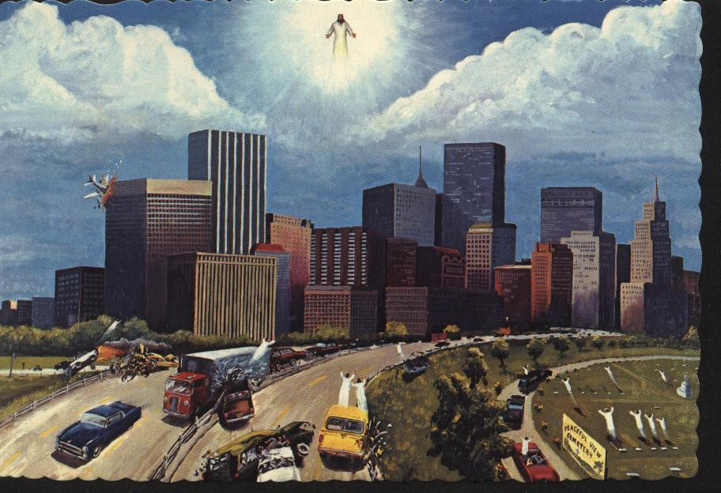
The Rapture

Slide 112

Pre-Trib
Mid-Trib
Post-Trib
Premillennialism
Marriage Supper
A
Revelation
Rapture
Comes for Saints
Comes with Saints
Tribulation
(7 years)
Israel
(Church Age)
Signs
3 ½ + 3 ½
GT
A
Kingdom
Postponed
Antichrist
Resurrection of Righteous
Living Saints Changed
All Caught Up
Resurrection of
Tribulation & OT Saints

Slide 113
Premillennialism
World Destroyed
(2 Pet. 3:10)
Final Judgment
Revelation
Millennial Kingdom
(1000 years)
Gog/Magog Revolt
Heaven
A
Satan Loosed
Hell
Satan bound
Jews Converted
Jews Returned to Land
OT worship restored
Idealistic life on earth
Resurrection of MK Saints
Resurrection of wicked

Slide 114
“There I was driving down the freeway and all of a sudden the place went crazy…cars going in all directions…and not one of them had a driver.” (Hal Lindsey, The Late Great Planet Earth, p. 124)

Slide 115
What Is The “Rapture”?
“It was the last quarter of the championship game and the other side was ahead. Our boys had the ball. We made a touchdown and tied it up. The crowd went crazy. Only one minute to go and they fumbled – our quarterback recovered – he was about a yard from the goal when – zap – no more quarterback – completely gone, just like that.” (Hal Lindsey, The Late Great Planet Earth, p. 126)

Slide 116
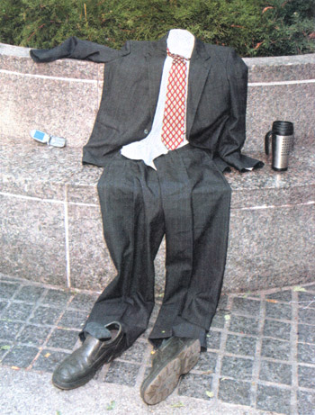
What Is The “Rapture”?
“Someday, a day that only God knows, Jesus Christ is coming to take away all those who believe in Him. He is coming to meet all true believers in the air. Without benefit of science, space suits, or interplanetary rockets, there will be those who will be transported into a glorious place more beautiful, more awesome, than we can possibly comprehend. Earth and all its thrills, excitement, and pleasures will be nothing in contrast to this great event.
“It will be the living end. The ultimate trip.” (Hal Lindsey, The Late Great Planet Earth, p. 126)

Slide 117



Slide 118
1 Thessalonians 4:13-18
¹³But I do not want you to be ignorant, brethren, concerning those who have fallen asleep, lest you sorrow as others who have no hope. ¹⁴For if we believe that Jesus died and rose again, even so God will bring with Him those who sleep in Jesus. ¹⁵For this we say to you by the word of the Lord, that we who are alive and remain until the coming of the Lord will by no means precede those who are asleep. ¹⁶For the Lord Himself will descend from heaven with a

Slide 119
1 Thessalonians 4:13-18
shout, with the voice of an archangel, and with the trumpet of God. And the dead in Christ will rise first. ¹⁷Then we who are alive and remain shall be caught up together with them in the clouds to meet the Lord in the air. And thus we shall always be with the Lord. ¹⁸Therefore comfort one another with these words.

Slide 120
Rapture Vs. Resurrection
The Rapture | The Resurrection
Invisible Coming | Visible Coming (1 Th. 4:16; Acts 1:11)
Secret Coming | Public Coming (1 Th. 4:16)
Righteous Dead Raised Before Unrighteous Dead | Righteous Dead Raised Before Righteous Living Changed (1Th. 4:16-17)
Only Righteous Resurrected | All Resurrected (Jn. 5:28-29; Acts 24:15)
Wicked Left Behind | None Left Behind (Mt. 13:24-30, 36-43, 47-50)
Only Righteous Rewarded | Righteous Rewarded (1 Th. 4:15-18) & Wicked Punished (2 Th. 1:6-10)

Slide 121
Parable Of Wheat & Tares
(Mt. 13:24-30, 36-43)
The Earthly Story | The Heavenly Meaning
Sower of good seed (24) | Son of Man (37)
Field (24) | World (38)
Good seeds (24) | Sons of the kingdom (38)
Tares (25) | Sons of the wicked one (38)
Enemy (25) | Devil (39)
Harvest (30) | End of the age (39)
Reapers (30) | Angels (39)
Tares gathered & burned (30) | Punishment of wicked (41-42)
Wheat gathered into barn (30) | Blessing of righteous (43)

Slide 122
Rapture Vs. Resurrection
The Rapture | The Resurrection
Marriage Supper in Heaven Tribulation on Earth | Judgment (Heb. 9:27; 2 Tim. 4:1-2)
Set Up Kingdom | Deliver Up Kingdom (1 Cor. 15:24)
Death Continues | Death Conquered (1 Cor. 15:25-26)
Three Comings (Incarnation, Rapture, & Revelation) | Second Coming (Heb. 9:26-28)
Three Resurrections | One Resurrection (Jn. 5:28-29)

Slide 123
The “Rapture”
Passage Doesn’t Mention
The Resurrection Of The Wicked
Contrast:
Not righteous dead & unrighteous dead
But righteous dead & righteous living
Point:
Dead Christians will be raised before living Christians are caught up with them to meet the Lord

Slide 124
Only Christians
(1 Th. 4:15-17)
¹⁵ For this we say to you by the word of the Lord, that we who are alive and remain until the coming of the Lord will by no means precede those who are asleep. ¹⁶ For the Lord Himself will descend from heaven with a shout, with the voice of an archangel, and with the trumpet of God. And the dead in Christ will rise first. ¹⁷ Then we who are alive and remain shall be caught up together with them in the clouds to meet the Lord in the air. And thus we shall always be with the Lord.

Slide 125
Only Christians
(1 Th. 4:13-17)
“It is clear also that both groups — the survivors and the dead (or those fallen asleep) — are believers. Anyone can see at once that the apostle is not drawing a contrast between believers and unbelievers, as if, for example, believers would rise first, and unbelievers a thousand years later. He states:
“‘And the dead in Christ will rise first; then we who are alive, who are left shall be caught up together with them in clouds …’
“Both groups ascend to meet the Lord. Both consist of nothing but believers.” (Hendriksen, 115)

Slide 126
Events On The Last Day
Major Premise
Righteous will be raised on the last day (Jn. 6:39-40, 44, 54; 11:24)
Minor Premise
Wicked will be judged on the last day (Jn. 12:48)
Conclusion
Resurrections of righteous & wicked will come at the same time (Jn. 5:28-29; Acts 24:15)

Slide 127
One Resurrection Of All
Jn. 5:28–29: ²⁸ Do not marvel at this; for the hour is coming in which all who are in the graves will hear His voice ²⁹ and come forth— those who have done good, to the resurrection of life, and those who have done evil, to the resurrection of condemnation.
Acts 24:15: ¹⁵ I have hope in God, which they themselves also accept, that there will be a resurrection of the dead, both of the just and the unjust.

Slide 128
Jn. 5:28-29: ²⁸ Do not marvel at this; for the hour is coming in which all who are in the graves will hear His voice ²⁹ and come forth— those who have done good, to the resurrection of life, and those who have done evil, to the resurrection of condemnation.
Rapture: Church Age saints hear, not wicked or OT saints
Revelation: Tribulation & OT saints hear, not wicked
Millennium: Wicked hear, not righteous

Slide 129
Paul’s Silence
Nature of the resurrection body
Resurrection of unbelievers
Judgment day
New heaven and the new earth
Hell
Final reign of God

Slide 130
“Rapture” Vs. “Revelation”
1st Phase: Rapture (1 Th. 4:13-18) | 2nd Phase: Revelation (2 Th. 1:6-10)
Christ returns in the air | Christ returns to the earth
Christ comes secretly for the church | Christ comes openly with the church & angels
Tribulation begins | Millennial kingdom begins
Translation imminent | Many signs precede
Translation a mystery | Revelation predicted
Believers escape Tribulation | Unbelievers experience Tribulation
Message of comfort for believers | Message of judgment for wicked

Slide 131
“Rapture” Vs. “Revelation”
1st Phase: Rapture (1 Th. 4:13-18) | 2nd Phase: Revelation (2 Th. 1:6-10)
Program for Church | Program for Israel & world
Believers are judged | Gentiles & Israel are judged
Israel’s covenants not fulfilled | Israel’s covenants all fulfilled
Only believers affected | All people affected
Judgment seat of Christ for believers | Sheep & goats judgment Antichrist & world judged
Church taken into Lord’s presence in heaven | All believers brought into Millennial Kingdom on earth
Major concern of 1 Thess. | Major concern of 2 Thess.

Slide 132
“Rapture” Vs. “Revelation”
1st Phase: Rapture (1 Th. 4:13-18) | 2nd Phase: Revelation (2 Th. 1:6-10)
Christ Comes For His Church | Christ Comes With His Church
Rapture Of All Christians | No Rapture For Anyone
Believers Taken To Father’s House | Resurrection Saints Don’t See Father’s House
No Judgment On Earth | Christ Judges Earth
Rapture Is Imminent | Revelation Can’t Occur For 7 Years
No Signs For Rapture | Many Signs Before Revelation
For Believers Only | For All Humanity

Slide 133
“Rapture” Vs. “Revelation”
1st Phase: Rapture (1 Th. 4:13-18) | 2nd Phase: Revelation (2 Th. 1:6-10)
Time Of Joy | Time Of Mourning
Before The Tribulation | After The Tribulation
No Mention Of Satan | Satan Bound 1000 Years
Judgment Seat Of Christ | No Time Or Place For Judgment
Marriage Of The Lamb | Bride Descends With Christ
Christ Seen By Believers Only | Christ Seen By All
Tribulation Begins | Millennial Kingdom Begins

Slide 134
“Rapture” & “Revelation”
Paul Jackson
G. Campbell Morgan
"After your long and full study and extensive exposition of the Bible, do you find any Scriptural warrant for the distinction which Bible teachers draw between the second coming of the Lord FOR his own (the rapture) and the coming of the Lord WITH his own (the revelation) with a time period of 3½ to 7 seven years between?"
"Emphatically not! I know this view very well. In the earlier years of my ministry I taught It and incorporated it in one of my books (God's Method With Man). …. The Idea of a separate and secret coming of Christ is a vagary of prophetic Interpretation without any Biblical basis whatsoever.“
(Christianity Today, Aug. 31, 1959)

Slide 135
1 Th. 5:2-9
² For you yourselves know perfectly that the day of the Lord so comes as a thief in the night. ³ For when they say, “Peace and safety!” then sudden destruction comes upon them, as labor pains upon a pregnant woman. And they shall not escape. ⁴ But you, brethren, are not in darkness, so that this Day should overtake you as a thief. ⁵ You are all sons of light and sons of the day. We are not of the night nor of darkness. ⁶ Therefore let us not sleep, as others do, but let us watch and be sober…. ⁹ For God did not appoint us to wrath, but to obtain salvation through our Lord Jesus Christ….

Slide 136
1 Th. 5:2-9
D. Michael Martin: “Those who believe the rapture of the church will precede the tribulation and thus the day of the Lord believe the reason the day of the Lord will not come upon them unexpectedly is that it will not come upon them at all. See J. F. Walvoord, The Blessed Hope and the Tribulation (Grand Rapids: Zondervan, 1976), 108-21.” (NAC, 33:159, n. 101)
Then Why Pray Tell Did Paul Warn Christians To Watch And Be Sober?

Slide 137
2 Th. 1:6-10
Rapture
⁵ which is manifest evidence of the righteous judgment of God, that you may be counted worthy of the kingdom of God, for which you also suffer; ⁶ since it is a righteous thing with God to repay with tribulation those who trouble you, ⁷ and to give you who are troubled rest with us when the Lord Jesus is revealed from heaven with His mighty angels, ⁸ in flaming fire taking vengeance on those who do not know God, and on those who do not obey the gospel of our Lord Jesus Christ. ⁹ These shall be punished with everlasting destruction from the presence of the Lord and from the glory of His power, ¹⁰ when He comes, in that Day, to be glorified in His saints
Revelation

Slide 138
Wiersbe On 2 Th. 1:6-10
“God will recompense tribulation to the lost, but rest to the saved. I believe that the first phrase in 2 Thessalonians 1:7 should be treated as a parenthesis: ‘to recompense tribulation to them that trouble you (and to you who are troubled, rest with us) when the Lord Jesus shall be revealed.’ The saints receive their rest when the Lord returns in the air and catches us up to be with Him.” (Wiersbe, “2 Thessalonians,” BEC, n.p.)

Slide 139
2 Th. 2:1-8
NU: “the day of the Lord”
Rapture
¹ Now, brethren, concerning the coming of our Lord Jesus Christ and our gathering together to Him, we ask you, ² not to be soon shaken in mind or troubled, either by spirit or by word or by letter, as if from us, as though the day of Christ had come. ³ Let no one deceive you by any means; for that Day will not come unless the falling away comes first, and the man of sin is revealed…. ⁶ And now you know what is restraining, that he may be revealed in his own time. ⁷ For the mystery of lawlessness is already at work; only He who now restrains will do so until He is taken out of the way. ⁸ And then the lawless one will be revealed, whom the Lord will consume with the breath of His mouth and destroy with the brightness of His coming.
Revelation

Slide 140
The Day of Christ
Day of Christ = The Rapture (Phil. 1:10; 2:16; 2 Th. 2:2^{RT})
Day of the Lord = The Revelation (Acts 2:20; 1 Cor. 5:5; 2 Cor. 1:14; 1 Th. 5:2; 2 Pet. 3:10)

Slide 141
Interchangeable Terms
Parousia | Epiphaneia | Apocalupsis | Phaneroo | Erchomai
2 Th. 2:1, 8 | 2 Th. 2:8
2 Th. 2:1 | 2 Th. 1:10 | 2 Th. 1:7
1 Jn. 2:28 |  |  | 1 Jn. 2:28; 3:2
Mt. 24:37, 39 |  |  |  | Mt. 24:42, 44

Slide 142
Interchangeable Terms
(Mt. 24:37, 39, 42, 44)
parousia
³⁷ But as the days of Noah were, so also will the coming of the Son of Man be. …. ³⁹ and did not know until the flood came and took them all away, so also will the coming of the Son of Man be. …. ⁴² Watch therefore, for you do not know what hour your Lord is coming. …. ⁴⁴ Therefore you also be ready, for the Son of Man is coming at an hour you do not expect.
parousia
erchomai
erchomai

Slide 143
Interchangeable Terms
(2 Th. 1:7, 10; 2:1, 8)
apocalypsis
erchomai
⁷ and to give you who are troubled rest with us when the Lord Jesus is revealed from heaven with His mighty angels…. ¹⁰ when He comes, in that Day, to be glorified in His saints and to be admired among all those who believe…. ¹ Now, brethren, concerning the coming of our Lord Jesus Christ and our gathering together to Him, we ask you…. ⁸ And then the lawless one will be revealed, whom the Lord will consume with the breath of His mouth and destroy with the brightness of His coming.
parousia
epiphaneia
parousia

Slide 144
Interchangeable Terms
(1 Jn. 2:28; 3:2)
phaneroo
²⁸ And now, little children, abide in Him, that when He appears, we may have confidence and not be ashamed before Him at His coming. …. ² Beloved, now we are children of God; and it has not yet been revealed what we shall be, but we know that when He is revealed, we shall be like Him, for we shall see Him as He is.
parousia
phaneroo

Slide 145
“Coming” & “Revelation”
2 Th. 2:1-2
1 Cor. 1:7-8
¹ Now, brethren, concerning the coming of our Lord Jesus Christ and our gathering together to Him, we ask you,
² not to be soon shaken in mind or troubled, either by spirit or by word or by letter, as if from us, as though the day of Christ had come.
⁷ so that you come short in no gift, eagerly waiting for the revelation of our Lord Jesus Christ, ⁸ who will also confirm you to the end, that you may be blameless in the day of our Lord Jesus Christ.
Parousia
Apocalupsis
NU: “the day of the Lord”

Slide 146
Boasting When???
2 Cor. 1:14
Phil. 2:16
¹⁴ (as also you have understood us in part), that we are your boast as you also are ours, in the day of the Lord Jesus.
¹⁶ holding fast the word of life, so that I may rejoice in the day of Christ that I have not run in vain or labored in vain.

Slide 147
Premillennial “Gaps”
Jn. 5:29a | 1,007 years | Jn. 5:29b
Psa. 110:1 | 1,947 years | Psa. 110:2-3
Psa. 110:4 | 1,947 years | Psa. 110:5-7
Dan. 9:27 | 1,900+ years | Dan. 9:28
Psa. 2:1-8 | 1,900+ years | Psa. 2:9-12
Amos 9:11a | 1,900+ years | Amos 9:11b-12
Jn. 5:29a | 7 years | Jn. 5:29a
2 Pet. 3:10a | 1,007 years | 2 Pet. 3:10b
Acts 24:15b | 1,000+ years | Acts 24:15b
1 Cor. 15:50-53 | 1,007 years | 1 Cor. 15:54-57
1 Th. 5:2-3 | 7 years | 1 Th. 5:4-9
2 Th. 2:1 | 7 years | 2 Th. 2:2

Slide 148
Summary
Paul’s “Rapture” is very different from Premillenialism’s “Rapture”
Premillenialism’s distinction between the “Rapture” and the “Revelation” is unwarranted
Premillenialism must postulate “gaps” in many passages without any contextual indication

Slide 149
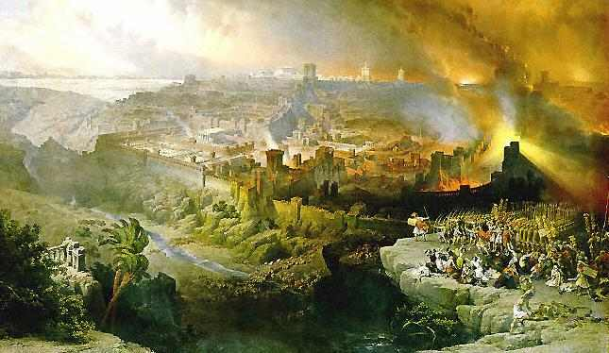
Realized Eschatology
The Second Coming
Occurred In AD 70

Slide 150
Realized Eschatology
Realized:
Accomplished, reached, or completed
Eschatology:
The study of last things
Realized Eschatology:
The doctrine that end times and last things have been reached or accomplished

Slide 151
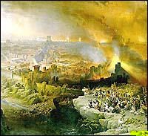
Mosaic Dispensation
Christian Dispensation
All Prophecy Fulfilled
“Last Days”
“Eternal Days”
Eschaton
End of Law
End of “Last Days”
Second Coming
Kingdom in Power & Glory
“Kingdom of God”
Eternal Kingdom
Resurrection of Dead
Redemption of Body
Perfection of Saints
Final Judgment
End Of World (Age)
New Heavens & Earth
AD 30
AD 70
Messianic Reign
“Kingdom of Christ”
Old & New Covenants

Slide 152
Second Coming In AD 70
Max King: “The end of the Jewish world was the second coming of Christ.” (Bold emphasis added, The Spirit Of Prophecy, 2002, 137)
Max King: “The fall of Jerusalem was the last day, and therefore the second coming of Christ.” (Bold emphasis added, The Spirit Of Prophecy, 2002, 243)

Slide 153
Spiritual Second Coming
Ed Stevens: “What we traditionally call ‘the second coming’ of Christ happened in that generation when Jerusalem was destroyed.” (What Happened in 70 A.D., quoted in Varner, 38)

Slide 154
Second Coming In AD 70
Max King: “Jesus Christ came in the fall of Jerusalem in 70 A.D., and FULFILLED THE SECOND COMING OF CHRIST AS TAUGHT IN THE PROPHECIES, in the EPISTLES, in the GOSPELS, as well as in the book of REVELATION.” (The Nichols-King Debate, 24)

Slide 155
Second Coming In AD 70
Max King: “I affirm the VISIBLE coming of Jesus Christ in the destruction of Jerusalem. And I affirm the ACTUAL coming, and the REAL coming of Jesus Christ in the destruction of Jerusalem?” (The Nichols-King Debate, 48)
Max King: “I affirm that Jesus came ACTUALLY and REALLY and TRULY and ACTUALLY and VISIBLY the second time.” (The Nichols-King Debate, 49)

Slide 156
Second Coming In AD 70
Jesus would come in destruction of Jerusalem (Mt. 24:3, 27, 30)
NT refers to an imminent coming of the Lord (Jas. 5:7-8; 1 Pet. 4:7, 17)
Only imminent coming was in destruction of Jerusalem
Therefore, the Second Coming was Jesus’ coming in judgment on Jerusalem in AD 70

Slide 157

Events At His Coming
Kingdom (Mt. 16:28; 2 Tim. 4:1)
End of the age (Mt. 24:3)
Mourning of tribes (Mt. 24:30; Rev. 1:7)
Gathering of elect (Mk. 13:26-27; 2 Th. 2:1)
Powers of heaven shaken (Lk. 21:26-27)
Redemption (Lk. 21:27-28)
Resurrection (1 Cor. 15:21-23; 1 Th. 4:15-16)
Judgment (Mt. 25:31ff; 2 Tim. 4:1)

Slide 158
Events At His Coming
Christians in Christ’s presence (1 Th. 2:19)
Hearts established blameless (1 Th. 3:13)
Spirit, soul, & body preserved blameless (1 Th. 5:23)
Destruction of lawless one (2 Th. 2:8)
Destruction of heavens & earth (2 Pet. 3:4, 7, 10-12)
New heavens & new earth (2 Pet. 3:12-13)

Slide 159
Events At “Coming”
(Parousia)
AD 70
Righteous raised (1 Cor. 15:22-23)
Wicked judged (Mt. 24:37-39)
Crown of boasting (1 Th. 2:19)
Hearts established (1 Th. 3:13)
Dead raised, living changed, then caught up (1 Th. 4:15-17)
Spirit, soul, body kept blameless (1 Th. 5:23)
Christians gathered to Christ (2 Th. 2:1)
Lawless one killed (2 Th. 2:8)
Heavens dissolved (2 Pet. 3:10-12)

Slide 160
Events At “Appearing”
(epiphaneia)
AD 70
Lawless one killed (2 Th. 2:8)
Living and dead judged (2 Tim. 4:1)
Crown of righteousness awarded (2 Tim. 4:8)
Blessed hope of Christian (Tit. 2:13)

Slide 161
Events At “Revelation”
(apokalupsis)
AD 70
Wrath for wicked (Rom. 2:5)
Creation freed from bondage (Rom. 8:19-23)
Redemption of body (Rom. 8:19-23)
Day of the Lord (1 Cor. 1:7-8)
Relief for righteous & vengeance for wicked (2 Th. 1:7-10)
Praise, glory, & honor for faithful (1 Pet. 1:7)
Grace for righteous (1 Pet. 1:13)
Joy & gladness for righteous (1 Pet. 4:13)

Slide 162
The Disciples’ Questions
Mt. 24:3 | Mk. 13:4 | Lk. 21:7
"Tell us, when will these things be? | "Tell us, when will these things be? | "Teacher, but when will these things be?
And what will be the sign | And what will be the sign | And what sign will there be
of Your coming, and of the end of the age? | when all these things will be fulfilled?" | when these things are about to take place?"
The Time & The Sign

Slide 163
Apostles Didn't
Understand
1 year before His death (Mt. 16:21-23)
6 months before His death (Lk. 9:43-45)
3 months before His death (Lk. 18:31-34)
1 week before His death (Lk. 19:11)
1 night before His death (Jn. 14:1-6; 16:16-22)
3 days after His death (Lk. 24:9-11; Jn. 20:8-10)
43 days after His death (Acts 1:6)
Sam Dawson: “They didn’t expect Jesus to go away the night before he died. They would not have asked about a final return, which they, at that time, didn’t believe in.” (Essays on Eschatology, 45)

Slide 164
The Apostles’ Questions
“Your coming” ➢ Invisible, impersonal coming in judgment (cf. Isa. 19:1; Mt. 10:23; 26:64)
“End of the world {age}” ➢ End of the Jewish age (1 Cor. 10:11; Heb. 9:26)
  “This age” = Pre-Messianic Age
  “The age to come” = Messianic Age
Apostles understood (Mt. 13:36-43, 51)

Slide 165
Is There A Transition?
Matthew 24 | Luke 17
Housetop and Field (Mt. 24:17-18) | Days of Noah (Lk. 17:26-30)
SUPPOSED TRANSITION (Mt. 24:34-35; Mk. 13:30-31; Lk. 21:32-33)
Days of Noah (Mt. 24:37-39) | Housetop and Field (Lk. 17:31)
In That Day

Slide 166
Is There A Transition?
Matthew 24 | Luke 17
Carcass and Eagles (Mt. 24:28) | 2 Women Grinding (Lk. 17:34-36)
SUPPOSED TRANSITION (Mt. 24:34-35; Mk. 13:30-31; Lk. 21:32-33)
2 Women Grinding (Mt. 24:41) | Body and Eagles (Lk. 17:37)
Where Lord?

Slide 167
All These Transitions???
(Lk. 17)
23-25: Destruction of Jerusalem
26-30: Second Coming
31-33: Destruction of Jerusalem
34-36: Second Coming
37: Destruction of Jerusalem

Slide 168
Is There A Transition?
“End” (Mt. 24:6, 13-14)
“Coming” (Mt. 24:3, 27, 30)
Destruction Of Jerusalem
SUPPOSED TRANSITION (Mt. 24:34-35; Mk. 13:30-31; Lk. 21:32-33)
Second Coming
“Coming” (Mt. 24:37, 39, 42, 44)

Slide 169
An Imminent Coming
Before disciples finished their evangelistic work (Mt. 10:16ff, 23; cf. Lk. 21:12ff, 20-24)
Before some disciples died (Mt. 16:27-28; Mk. 9:1)
Before “this generation” passed away (Mt. 24:30, 34; Mk. 13:26, 30; Lk. 21:27, 32)
When Caiaphas could see it (Mt. 26:57, 62, 64)
Your redemption draws “near” (Lk. 21:28)

Slide 170
An Imminent Coming
Kingdom of God is “near” (Lk. 21:31)
Salvation nearer (Rom. 13:11)
The day is “at hand” (Rom. 13:12)
Crush Satan under feet shortly (Rom. 16:20)
Corinthians “eagerly waiting for the revelation” (1 Cor. 1:7)
Lord is “at hand” (Phil. 4:5)
Day approaching (Heb. 10:25)

Slide 171
An Imminent Coming
A little while He who is coming will come (Heb. 10:37)
Coming of the Lord is “at hand” (Jas. 5:7-8)
Salvation ready to be revealed in the last time (1 Pet. 1:5)
End of all things “at hand” (1 Pet. 4:7)
Time has come for judgment on house of God (1 Pet. 4:17)

Slide 172
An Imminent Coming
“It is the last hour” (1 Jn. 2:18)
Things shortly take place (Rev. 1:1, 3; 22:6-7)
I will come to you “quickly” (Rev. 2:5, 16)
Hold fast till I come (Rev. 2:25)
I am coming “quickly” (Rev. 3:11; 22:7, 12, 20)
Time is near (Rev. 22:10)

Slide 173
Specific Pronouns
1 Cor. 1:7-8: ⁷ so that you come short in no gift, eagerly waiting for the revelation of our Lord Jesus Christ, ⁸ who will also confirm you to the end, that you may be blameless in the day of our Lord Jesus Christ.
1 Th. 5:4: ⁴ But you, brethren, are not in darkness, so that this Day should overtake you as a thief.
Fulfillment Expected In Their Lifetime

Slide 174
Specific Pronouns
1 Th. 4:15–16: ¹⁵ For this we say to you by the word of the Lord, that we who are alive and remain until the coming of the Lord will by no means precede those who are asleep. ¹⁶ For the Lord Himself will descend from heaven with a shout, with the voice of an archangel, and with the trumpet of God. And the dead in Christ will rise first.
If the “coming of the Lord” was AD 70 and Paul included himself when he said “we,” he was wrong, because he was executed before AD 70
Fulfillment Expected In Their Lifetime

Slide 175
Specific Pronouns
Gen. 49:1: And Jacob called his sons and said, "Gather together, that I may tell you what shall befall you in the last days:
Gen. 49:10: ¹⁰ The scepter shall not depart from Judah, Nor a lawgiver from between his feet, Until Shiloh comes; And to Him shall be the obedience of the people.

Slide 176
RE Assumptions
“The age” & “this age” always mean the same thing
“The age” & “this age” = Jewish age
Jesus was talking about the Jewish age
Disciples really understood when they said they did
Apostles were using the same terminology the same way in two different contexts a year apart
“The end” is always the same event

Slide 177
Same Term But
Different Meanings
Term | Meaning #1 | Meaning #2
Baptism | Water (Acts 8:36) | Suffering (Mk. 10:38-40)
Pneuma | Spirit (Jn. 3:5-6) | Wind (Jn. 3:8)
Death | Physical (Mt. 8:22) | Spiritual (Mt. 8:22)
Sanctified | Set apart from sin to God (1 Cor. 6:11) | Marriage legitimized (1 Cor. 7:14)
Faith | Gospel (Jude 3) | Conscience (Rom. 14:23)
Elements | Basic principles (Heb. 5:12) | Elements of world (2 Pet. 3:10, 12)
Coming | 1st Coming (1 Tim. 1:15) | 2nd Coming (Heb. 9:26-28)
Raised | Literal Resurrection (Mt. 11:5) | Figurative Resurrection (Col. 2:12)

Slide 178
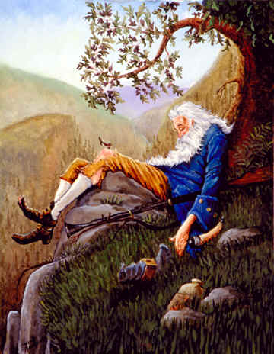
“Sleep” In Three Senses
Spiritual lethargy
(1 Th. 5:6)
Natural sleep
(1 Th. 5:7)
Death
(1 Th. 5:10)

Slide 179
Laying On Of Hands
Bless (Mt. 19:13-15)
Comfort (Rev. 1:17)
Seize (Mt. 18:28)
Appoint or ordain (Acts 6:6; 13:3; 1 Tim. 5:22)
Heal (Mt. 9:18; Mk. 5:23; 6:5; 16:18; Lk. 4:40; 13:13; Acts 28:8)
Arrest (Mt. 21:46; 26:50; Mk. 14:46; Lk. 20:19; 21:12; Jn. 7:30, 44; 8:20; Acts 4:3; 5:18; 21:27)
Impart spiritual gifts (Acts 8:17-19; 19:6; 1 Tim. 4:14; 2 Tim. 1:6; Heb. 6:2)

Slide 180
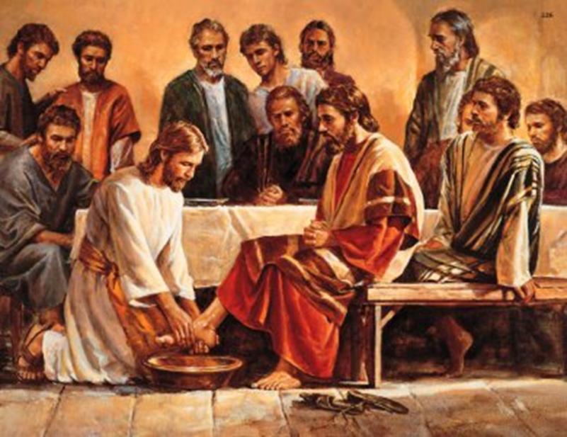
Slow To Understand
Jesus’ teaching
(Mt. 15:10-20; 16:5-12)
Jesus’ miracles
(Mk. 6:30ff, 51-52)
Jesus’ death
(Mt. 16:21-23; Mk. 9:30-32; Lk. 18:31-34; Jn. 14:1-5; 16:16-20; Lk. 24:44-47)

Slide 181
What Did They Understand?
A Harvest
At the end of the Jewish Age
At the end of the world

Slide 182
“The End”
Samaria in 722 BC (Amos 8:1-3, 10)
Nineveh in 612 BC (Nah. 1:8-9)
Jerusalem in 586 BC (Ezek. 7:1-9; Hab. 2:2-3)
Babylon in 539 BC (Dan. 5:26)
Jewish persecution in 168 BC (Dan. 8:17, 19)
Kings of the North and South (Dan. 11:27, 35, 40; 12:4, 8-9, 13)
Jerusalem in AD 70 (Dan. 9:26-27; Mt. 24:3, 6, 13-14)
Final Coming (Mt. 13:39; 1 Cor. 15:24-28)

Slide 183
“The End” Might Be
End of persecution (Mt. 10:17-23)
Destruction of Jerusalem (Mt. 24:6, 13-14; Mk. 13:7, 13; Lk. 21:9; cf. Mt. 10:17-23; 1 Pet. 4:7)
End of Jesus’ trial (Mt. 26:58)
End of Jesus’ life (Jn. 13:1)
End of life (1 Cor. 1:8; 2 Cor. 1:13; Heb. 3:6, 14; 6:11-12; Rev. 2:26)
Second Coming (1 Cor. 15:24)

Slide 184
Jesus Can Teach
Beyond Man’s Understanding
Destroy this temple (Jn. 2:19-22)
The new birth (Jn. 3:3-10)
Living water (Jn. 4:7-15)
Lazarus sleeps (Jn. 11:11-14)
Jesus Was Not Limited By The Apostles' Understanding (Mt. 24:1-3)

Slide 185
Lk. 17 & Olivet Discourse
Two Important Points
Lk. 17 is not a parallel passage
The same language can mean different things in different contexts

Slide 186
Metaphors & Meanings
Hiding your light under a bushel
Let influence be seen (Mt. 5:15)
Parables reveal truth (Mk. 4:21)
Truth about Christ is evident (Lk. 11:33)
Leaven Of Scribes & Pharisees
Their teaching (Mt. 16:6, 12; Mk. 8:15)
Their hypocrisy (Lk. 12:1)

Slide 187
Metaphors & Meanings
To Him Who Has, More Will Be Given
Parables are a means of sifting (Mt. 13:12; Mk. 4:25; Lk. 8:18)
Judgment and unused opportunities (Mt. 25:29; Lk. 19:26)
Settle With An Adversary Quickly
Reconciliation with men (Mt. 5:25-26)
Reconciliation with God (Lk. 12:58-59)

Slide 188
Metaphors & Meanings
Measure You Use, It Will Be Measured Back To You
Judging (Mt. 7:1-2)
Attention to God's word (Mk. 4:24-25)
Generosity (Lk. 6:37-38)
Lamp Of The Body Is The Eye
Single-minded service (Mt. 6:22-23)
Failure to recognize Christ (Lk. 11:34-36)

Slide 189
Metaphors & Meanings
Tree Known By Its Fruit
Applied to teachers (Mt. 7:16-20)
Applied to blasphemers (Mt. 12:33)
Applied to hypocrites (Lk. 6:43-44)
Salt Of The Earth
Importance of influence (Mt. 5:13)
Commitment (Mk. 9:50)
Importance of self-sacrifice (Lk. 14:34)

Slide 190
Metaphors & Meanings
Slave Not Greater Than Master
Students not greater than teachers (Lk. 6:40)
Necessity of humility (Jn. 13:16)
Inevitability of persecution (Mt. 10:24; Jn. 15:20)

Slide 191
Metaphors & Meanings
What Is Covered Will Be Revealed
Don’t hide your relationship with Christ
(Mt. 10:26-27)
Parables reveal truth (Mk. 4:22; Lk. 8:17)
Sin will ultimately be revealed (Lk. 12:2-3)

Slide 192
Significant Contrasts
Dest. Of Jerusalem | Coming Of The Lord
“Days” (24:19, 22, 29) | “Day” (24:36, 42, 44, 50; 25:13)
“Know” (24:15, 33) | “Know Not” (24:36, 42, 44, 50; 25:13)
Abnormal Times (24:4-13) | Normal Times (24:37-42)
Warning (24:32-33) | No Warning (24:43-44)

Slide 193
Significant Contrasts
Dest. Of Jerusalem | Coming Of The Lord
Flight Possible (24:16) | Flight Impossible (24:39, 43-44)
Local Judgment (24:15-22) | Universal Judgment (25:31-46)
Imminent Judgment (24:15-16, 34) | Delayed Judgment (24:48, 50; 25:5, 19)
Time Follows Judgment (24:15-18; cf. Lk. 21:22-24) | Eternity Follows Judgment (25:46)

Slide 194
The Disciples’ Questions
Mt. 24:3 | Mk. 13:4 | Lk. 21:7
"Tell us, when will these things be? | "Tell us, when will these things be? | "Teacher, but when will these things be?
And what will be the sign | And what will be the sign | And what sign will there be
of Your coming, and of the end of the age? | when all these things will be fulfilled?" | when these things are about to take place?"
Mt. 24:36-25:46
The Time & The Sign

Slide 195
“Comings” Of The Lord
Incarnation (Jn. 1:11; 3:31; Acts 7:51-52; 1 Tim. 1:15; 2 Tim. 1:10; Heb. 9:26)
Giving of Holy Spirit (Jn. 14:16-18, 28)
Indwelling of Deity (Jn. 14:23)
Ascension (Dan. 7:13-14)
Coming in His Kingdom (Mt. 16:27-28; cf. Mk. 8:38; 9:1; Lk. 9:26-27)
Preaching Gospel to Gentiles (Eph. 2:17)

Slide 196
“Comings” Of The Lord
Punishing or Blessing Churches (Rev. 2:5, 16, 25; 3:3, 11, 20; 16:15; 22:7, 12, 20)
Destruction of Jerusalem (Mal. 4:1, 5; Mt. 10:23; 23:37-39; 24:3, 27, 30; 26:64; Mk. 13:26; Lk. 21:27; Heb. 10:37; Jas. 5:7-8)
Judgment on the Beasts and Babylon (Rev. 1:7; 11:16-18; 14:14-20; 16:4-7; 19:1-2, 11-16, 19-21)
Final Coming (Mt. 24:42-44; 25:31-33; Lk. 18:6-8; Jn. 14:1-3; 21:22-23; Acts 1:9-11; 1 Cor. 15:23; 1 Th. 3:11-13; 4:13-18; 5:23; 2 Th. 1:6-10; 2:1-3; 1 Tim. 6:13-16; 2 Tim. 4:1; Heb. 9:28; 2 Pet. 3:10-13)

Slide 197
Imminent Comings
Not
AD 70
Coming in Holy Spirit (Jn. 14:16-18, 28)
Imminent (Acts 1:4-5)
Fulfilled on Pentecost (Acts 2:1-4)
Coming to 7 churches
Imminent (Rev. 2:5, 16; 3:3, 11-12)
Dependent upon repentance or faithfulness (Rev. 2:5, 16; 3:3, 11, 19-20)
To the church (Rev. 2:5, 16; 3:3) or the Christian (Rev. 3:20)

Slide 198
Comings Of The Lord
Conditional Coming
Unconditional Coming
To Indwell (Jn. 14:23)
To Ephesus (Rev. 2:5)
To Pergamos (Rev. 2:16)
To Thyatira (Rev. 2:22)
To Sardis (Rev. 3:3)
Destruction of Jerusalem (Mt. 23:37-39; 24:29-31)
Second Coming (Jn. 14:1-3; Tit. 2:13; 2 Pet. 3:10)

Slide 199
Imminent Passages
Many definitely refer to destruction of Jerusalem in AD 70 (Mt. 10:23; 24:30, 34; 26:64; Lk. 21:28, 31)
Some others may refer to destruction of Jerusalem in AD 70 (Mt. 16:27-28; Heb. 10:25, 37)
Some may refer to personal salvation at death (Rom. 13:11-12)

Slide 200
Imminent Passages
Some may speak of spatial nearness, not temporal (Phil. 4:5; cf. Acts 17:27)
Some may refer to the Lord’s judgment in time, but not necessarily AD 70 (Jas. 5:7-8)
Some cannot refer to destruction of Jerusalem in AD 70 (Rev. 2:5, 16, 25; 3:11)

Slide 201
Delayed Coming
Like flood in Noah’s days (Mt. 24:36-39; cf. 1 Pet. 3:20; Gen. 6:3)
Master delayed return (Mt. 24:48-51)
Bridegroom delayed coming (Mt. 25:5)
Lord returned “after a long time” (Mt. 25:19)
After a falling away (2 Th. 2:1-5)
“Where is the promise of His coming?” (2 Pet. 3:4)

Slide 202
A Coming That
Doesn’t Fit AD 70
Coming to judge all nations (Mt. 25:31-33)
Coming like Jesus’ ascension (Acts 1:9-11)
Coming that is personal, audible, and visible (1 Th. 4:13-18)
Coming to punish the ungodly (Jude 14-15; 2 Pet. 3:7; Jn. 12:48; 2 Th. 1:7-10)
Coming to destroy the heavens and the earth (2 Pet. 3:3-13)

Slide 203
Which Makes More Sense?
Coming Of The Lord | AD 70 | Future
Judge all nations (Mt. 25:31-33) | ❑ | ❑
Like Jesus’ ascension (Acts 1:9-11) | ❑ | ❑
Personal, audible, & visible coming (1 Th. 4:13-18) | ❑ | ❑
Punish ungodly (Jude 14-15; 2 Pet. 3:7; Jn. 12:48; 2 Th. 1:7-10) | ❑ | ❑
Destroy heavens & earth (2 Pet. 3:3-13) | ❑ | ❑

Slide 204
Ascension & Second Coming (Acts 1:9-11)
Literal Ascension
⁹ Now when He had spoken these things, while they watched, He was taken up, and a cloud received Him out of their sight. ¹⁰ And while they looked steadfastly toward heaven as He went up, behold, two men stood by them in white apparel, ¹¹ who also said, "Men of Galilee, why do you stand gazing up into heaven? This same Jesus, who was taken up from you into heaven, will so come in like manner as you saw Him go into heaven."
Bodily Ascension
(Lk. 24:39, 50-51)
Visible Ascension
Identical Return

Slide 205
“In Like Manner”
Kenneth Gentry: “The Greek on tropon literally means ‘what manner.’ The Greek phrase ‘never indicates mere certainty or vague resemblance; but wherever it occurs in the New Testament, denotes identity of mode or manner’ (A. Alexander, Acts, ad loc.). Consequently, we have express biblical warrant to expect a visible, bodily, glorious return of Christ paralleling in kind the ascension.” ("A Brief Analysis of Full Preterism or Hyper Preterism," http://fide-o.com/2009/05/full-preterism/)

Slide 206
“In Like Manner”
Barclay M. Newman: “In the same way refers to the manner of the Lord’s return, that is, on the clouds of heaven, as is depicted in other passages of the New Testament. This may be rendered in some languages as ‘just like he went.’” (A Handbook on The Acts of the Apostles, 21)
“Not another and in a different way, but this same Jesus in the same way, would descend for believers as they had seen Him ascend from them.” (KJVBC, 2129)

Slide 207
The Return Of Jesus
Major Premise
Jesus will return bodily and visibly (Acts 1:9-11; 1 Th. 4:13-18)
Minor Premise
Jesus did not return bodily and visibly in AD 70
Conclusion
Therefore, Jesus will return bodily and visibly at some future time

Slide 208
1 Thess. 4:16-17
Personal
Audible
¹⁶ For the Lord Himself will descend from heaven with a shout, with the voice of an archangel, and with the trumpet of God. And the dead in Christ will rise first. ¹⁷ Then we who are alive and remain shall be caught up together with them in the clouds to meet the Lord in the air. And thus we shall always be with the Lord.
Visible

Slide 209
Coming Bodily & Visibly?
Coming in His kingdom (Mt. 16:28)
Sending of Holy Spirit (Jn. 14:18)
Judgment on Jerusalem (Mt. 24:29-31)
Coming to preach to Gentiles (Eph. 2:17)
Coming to bless or punish churches (Rev. 2:5, 16, 25; 3:3, 11, 20; 16:15; 22:7, 12, 20)
Coming to punish persecutors (Rev. 11:16-18)

Slide 210
Mt. 24 & 1 Th. 4 & 5
Mt. 24 |  | 1 Th. 4 & 5
24:30 | Christ Himself returns | 4:16
24:30 | From Heaven | 4:16
24:30 | With A Shout (In Power) | 4:16
24:31 | Accompanied By Angels | 4:16
24:31 | With Trumpet | 4:16
24:31 | Believers Gathered | 4:16
24:30 | In Clouds | 4:17

Slide 211
Mt. 24 & 1 Th. 4 & 5
Mt. 24 |  | 1 Th. 4 & 5
24:36 | Time Unknown | 5:1-2
24:43 | Coming As A Thief | 5:2, 4
24:37-39 | Unbelievers Unaware | 5:3
24:8 | Judgment Comes As Travail | 5:3
24:42 | Believers To Watch | 5:4
24:49 | Warning Against Drunkenness | 5:7

Slide 212
Fanciful Interpretation
D. R. Dungan: “Rule 8. It must be remembered that figures are not always used with the same meaning.--A lion may not always symbolize the same thought, nor need a sheep, water, or fire always be employed for the purpose of expressing the same calamity or blessing.
“There is a very grave error among an untaught class of exegetes in compelling every word that has, at any time, been used figuratively, to always represent the same thought as in that passage.” (Hermeneutics, 216)

Slide 213
Fanciful Interpretation
D. R. Dungan: “Many seem disposed to regard themselves as at liberty to make anything out of the Bible which their theology may demand or their whims require. And if, at any time, they find a passage that will not harmonize with that view, then the next thing is to find one or more words in the text used elsewhere in a figurative sense, and then demand that such be the Biblical dictionary on the meaning of that word, and hence that it must be the meaning in that place.” (Hermeneutics, 217)

Slide 214
JW’s On “Soul” & “Spirit”
Jehovah's Witnesses
Bible
Physical life (Gen. 1:20, 24; 2:7; Acts 20:9-10)
Persons (Ezek. 18:20; Acts 2:41-42)
Physical life (Gen. 1:20, 24; 2:7; Acts 20:9-10)
Spiritual life (Mt. 10:28; Jas. 1:21)

Slide 215
Are They Really Parallel?
Mt. 24 | 1 Th. 4 & 5
??? | God will bring with Him those who sleep (4:14)
??? | Living will not precede dead (4:15)
??? | Lord descend with a shout (4:16)
??? | Voice of archangel (4:16)
??? | Dead in Christ will rise first (4:16)
??? | Living & dead caught up in clouds to meet Lord (4:17)
??? | Always be with Lord (4:17)

Slide 216
Are They Really Parallel?
Mt. 24 | 1 Th. 4-5
Son of Man coming on clouds (24:30) | Believers ascending in clouds (4:17)
Angels gather (24:31) | Christ gathers (4:17)
Nothing said about resurrection | Main theme is resurrection
Nothing about order of ascent | Order of ascent is principle lesson

Slide 217
Mt. 24 & 2 Th. 1 & 2
Mt. 24 |  | 2 Th. 1 & 2
24:3, 30 | Coming of Lord | 2:1
24:31 | Gathering together to Him | 2:1
24:6; Mk. 13:7 | Troubled | 2:2
 | Day of Christ | 2:2
 | Falling away | 2:3
 | Man of sin
 | Son of perdition
24:15 | Sits in temple | 2:4

Slide 218
Mt. 24 & 2 Th. 1 & 2
Mt. 24 |  | 2 Th. 1 & 2
 | You know what is restraining | 2:6
 | Mystery of lawlessness | 2:7
 | He who now restrains | 2:7
 | He is taken away | 2:7
 | Lawless one revealed | 2:8
 | Lord consume with breath | 2:8
 | Destroy with brightness of coming | 2:8
 | Working of Satan | 2:9

Slide 219
Mt. 24 & 2 Th. 1 & 2
Mt. 24 |  | 2 Th. 1 & 2
 | Power, signs, & lying wonders | 2:9
 | All unrighteous deception | 2:10
 | Did not receive love of truth | 2:10
 | Strong delusion | 2:11
 | Condemned who did not believe truth | 2:12

Slide 220
If Second Coming In AD 70
What is so remarkable about Jesus’ statement about John? (Jn. 21:20-23)
Why can’t we judge the hidden things of the heart? (1 Cor. 4:1-5)
Why do we still observe the Lord’s Supper? (1 Cor. 11:23-26)
  Lord’s Supper no longer proclaims Christ’s death
  Lord’s Supper no longer applicable

Slide 221
If Second Coming In AD 70
Why is realized eschatology “unrealized” in early post-apostolic writings?
  See Almon Williams (“AD 70: The End?” The Doctrine of Last Things, 1986, 216-219)
  See Terry Varner (Studies in Biblical Eschatology, 1:78-97)

Slide 222
“Unrealized” Eschatology
Almon Williams: “...since there is not even a single extant voice among them in favor of realized eschatology, most people will find it very difficult to believe that this third generation could all be wrong about these matters, especially when some of them, for example, Polycarp, probably knew some of the apostles. That is, if the AD 70 doctrine were the NT doctrine, to believe that by AD 90 to AD 150, a complete blackout of such had taken place is very difficult to believe, if not impossible.” (“AD 70: The End?” The Doctrine of Last Things, 1986, 219)

Slide 223
“Unrealized” Eschatology
Almon Williams: “…if the pre-AD 70 Christians believed in an AD 70 eschatology, they must have made it their best kept secret because their successors of the second and third generations show absolutely no acquaintance with it.” (“AD 70: The End?” The Doctrine of Last Things, 1986, 219)

Slide 224
No Hyper-Preterism In
Early Post-Apostolic Period
Clement of Rome (1 Clement 50:3, ANF, 1:19; Homily, Chap. 17, ANF, 7:522)
The Didache (10:5; 16:1-5)
Justin Martyr (Dialogue, Chap. 35, ANF, 1:212; Chap. 110, ANF, 1:253)
Irenaeus (Against Heresies, 4:33, ANF, 1:506, 510)

Slide 225
No Hyper-Preterism In
Early Post-Apostolic Period
Cyprian (Epistle 62, ANF, 5:363; Treatise 6, ANF, 5:468)
Polycarp (Epistle to the Philippians, Chap. 2, ANF, 1:33; Chap. 6, ANF, 1:34; Chap. 7, ANF, 1:34)
Ignatius (Epistle to the Trallians Chap. 9, ANF, 1:70; Letter to Polycarp Chap 3, ANF, 1:94)

Slide 226
Summary
There are many comings of the Lord in the NT
There are imminent comings of the Lord that cannot refer to AD 70
There is a delayed coming of the Lord in the NT
There is a coming of the Lord that doesn’t fit AD 70

Slide 227
Why Don't We Think More About
The Second Coming?
Overreaction to false date-setting predictions
Not emphasized in our teaching
Long delay – “odds” are against it
Living in peaceful and prosperous times

Slide 228
The Second Coming
          A great motivation to evangelism (1 Th. 2:19-20)
          A great motivation to Christian stability (1 Th. 3:11-13)
          A wonderful comfort in sorrow (1 Th. 4:13-18)
          A great encouragement to godly living (1 Th. 5:23-24)

