Slide 1
Alleged Contradictions in the Gospels

Slide 2
Understanding the Problem
“You can be physically in New York right now and mentally three thousand miles away in San Francisco. But you cannot right now be physically… both in New York and in San Francisco. Two statements are in contradiction if what one says completely negates what the other says… Both of these statements cannot be true. If one is true, the other must be false, and vice versa.” (D.Q. McInerny)
Types of Contradictions
Historical Contradictions (“No Historical Evidence”)
Horizontal Contradictions (Comparing Gospel Accounts)
Claim: “Reliability of Scriptures at Stake”

Slide 3
Principle #1 – Complimentary Accounts
Judas’ Death
“⁵And throwing down the pieces of silver into the temple, he departed, and he went and hanged himself. ⁶But the chief priests, taking the pieces of silver, said, ‘It is not lawful to put them into the treasury, since it is blood money.’ ⁷So they took counsel and bought with them the potter's field as a burial place for strangers.” (Matthew 27:5-8) | “¹⁸Now this man acquired a field with the reward of his wickedness, and falling headlong he burst open in the middle and all his bowels gushed out. ¹⁹And it became known to all the inhabitants of Jerusalem, so that the field was called in their own language Akeldama, that is, Field of Blood.” (Acts 1:18-19)
“However mysterious it may be to say that he fell headlong and burst open, at the least that is not ‘hanging’ oneself.” Bart Ehrman

Slide 4
Principle #1 – Complimentary Accounts
Angels at Tomb
“And entering the tomb, they saw a young man sitting on the right side, dressed in a white robe, and they were alarmed.” (Mark 16:5) | “And she saw two angels in white, sitting where the body of Jesus had lain, one at the head and one at the feet.” (John 20:12)
Women at Tomb
“Mary Magdalene.” (John 20:1)
“Mary Magdalene and the other Mary.” (Matthew 28:1)
“Mary Magdalene, Mary the mother of James, and Salome.” (Mark 16:1)
“Mary Magdalene and Joanna and Mary the mother of James and the other women.” (Luke 24:10)

Slide 5
Principle #1 – Complimentary Accounts
Jerusalem or Galilee
“And behold, I am sending the promise of my Father upon you. But stay in the city until you are clothed with power from on high.” (Luke 24:49) | “Now the eleven disciples went to Galilee, to the mountain to which Jesus had directed them.” (Matthew 28:16)
“In Matthew’s version the disciples are told to go to Galilee to meet Jesus, and they immediately do so. He appears to them there and gives them their final instruction. But in Luke the disciples are not told to go to Galilee… And they never leave Jerusalem – in the southern part of Israel, a different region from Galilee, in the north.” (Bart Ehrman)

Slide 6
Principle #1 – Complimentary Accounts
Jesus & Passover Meal
“And on the first day of Unleavened Bread, when they sacrificed the Passover lamb, his disciples said to him, ‘Where will you have us go and prepare for you to eat the Passover?’” (Mark 14:12)
“They themselves did not enter the governor's headquarters, so that they would not be defiled, but could eat the Passover.” (John 18:28)
“Now the Feast of Unleavened Bread drew near, which is called the Passover.” (Luke 22:1)
“Jesus held his Passover meal not on the official day, but deliberately one day earlier.” (R.T. France)

Slide 7
Principle #2 – Respect Ancient Writing
“The more we learn about ancient historians (Herodotus, Thucydides, Polybius), and about Greco-Roman biographies (of which the Gospels are likely an example), the more we learn how ancient practices were different from our own. In the ancient world, for instance, it was common to tell stories out of order (for thematic reasons), paraphrase and reword quotations, conflate and abridge material, streamline the timeline of events, and so on.”
Michael Kruger

Slide 8
Principle #2 – Respect Ancient Writing
Inscription Above Cross
“This is Jesus, the King of the Jews.” (Matthew 27:37)
“The King of the Jews.” (Mark 15:26)
“This is the King of the Jews.” (Luke 23:38)
“Jesus of Nazareth, the King of the Jews… and it was written in Aramaic, in Latin, and in Greek.” (John 19:19, 20b)
Curtain Tearing
“³⁷And Jesus uttered a loud cry and breathed his last. ³⁸And the curtain of the temple was torn in two, from top to bottom.” (Mark 15:37-38)
“^{45b}And the curtain of the temple was torn in two. ⁴⁶Then Jesus, calling out with a loud voice, said, ‘Father, into your hands I commit my spirit!’” (Luke 23:45b-46)

Slide 9
Principle #2 – Respect Ancient Writing
Timing of Crucifixion
“And it was the third hour when they crucified him.” (Mk 15:25)
“Now it was the day of Preparation of the Passover. It was about the sixth hour.” (John 19:14)
“The reckoning of time for most people, who could not very well carry sundials and astronomical charts, was necessarily approximate. If the sun was moving toward mid-heaven, two different observers might well have glanced up and decided, respectively, that it was ‘the third hour’ or ‘about the sixth hour’. Mark’s concern is to set a time frame in which the three hours of darkness occur (Mk. 15:25, 33).” (D.A. Carson)

Slide 10
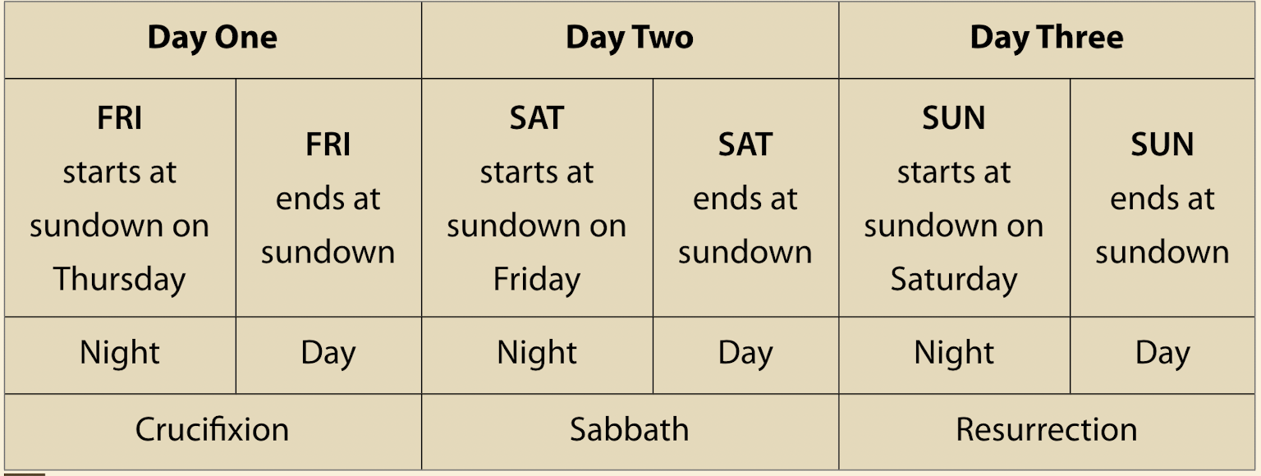
Principle #2 – Respect Ancient Writing
Three Days & Three Nights
“For just as Jonah was three days and three nights in the belly of the great fish, so will the Son of Man be three days and three nights in the heart of the earth.” (Matthew 12:40)
“He was buried, that he was raised on the third day in accordance with the Scriptures…” (1 Cor. 15:4)

Slide 11
Principle #2 – Respect Ancient Writing
“the expression ‘three days and three nights’ is an idiom which covers any parts of three days and three nights.” (Bullinger, p. 845)
“^{12b}And when he had eaten, his spirit revived, for he had not eaten bread or drunk water for three days and three nights. ¹³And David said to him, ‘To whom do you belong? And where are you from? He said, ‘I am a young man of Egypt, servant to an Amalekite, and my master left me behind because I fell sick three days ago.’” (1 Samuel 30:12b-13)

Slide 12
Suggestions for Discussions
“²⁴And the Lord's servant must not be quarrelsome but kind to everyone, able to teach, patiently enduring evil, ²⁵correcting his opponents with gentleness. God may perhaps grant them repentance leading to a knowledge of the truth ²⁶and they may come to their senses and escape from the snare of the devil, after being captured by him to do his will.” (2 Timothy 2:24-26)
Ask Questions (Don’t Always Go on the Offensive)
Are There Things In the Bible You Don’t Like?
Did You Have a Bad Religious Experience?
What is the Best Answer You Could Imagine?
What is the Best Answer You’ve Heard?
Even if There Were Contradictions…

